Slide 1

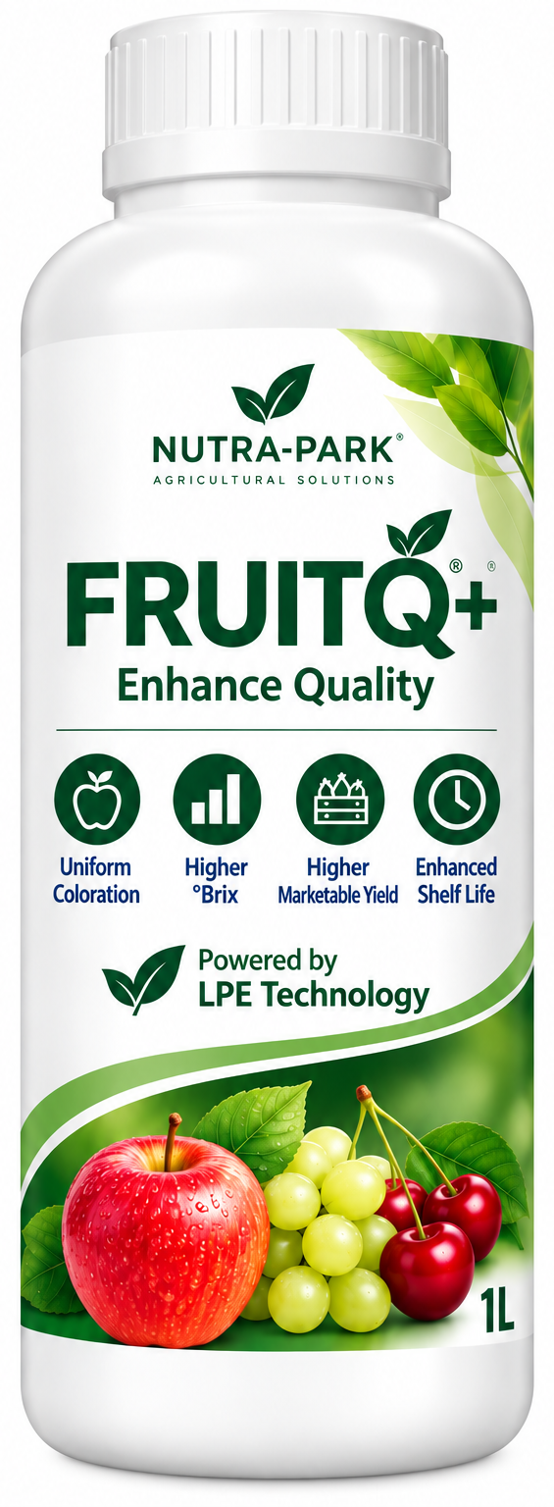





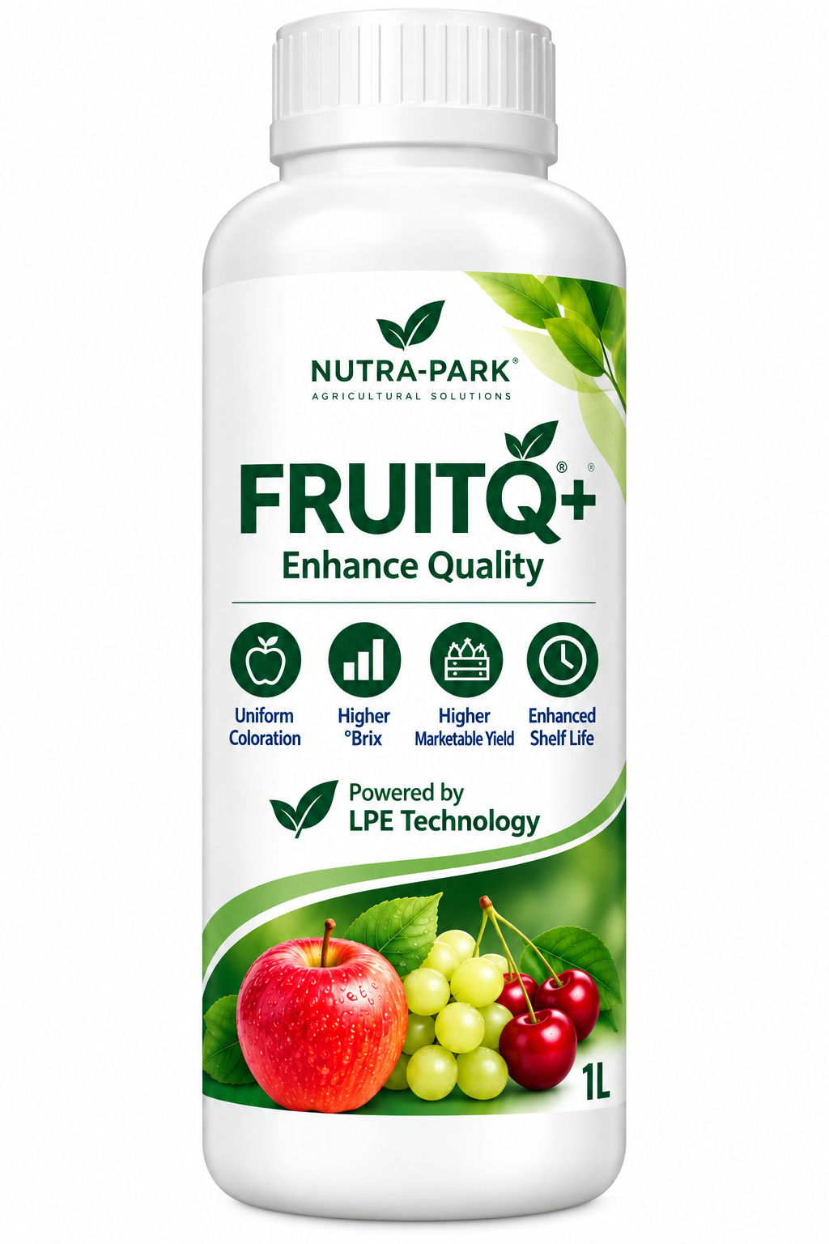
FRUITQ+ FIELD TRIAL
Strawberry · Huzhou, China
FIELD EVIDENCE
Brix · Firmness · Fruit Weight · Coloration
Wang Erhao Strawberry Farm
Nov. 18, 2024 – Feb. 19, 2025
Enhance Quality
Powered by LPE Technology

Slide 2
Field Trial
Trial overview
● Location: Wang Erhao Strawberry Farm, Huzhou, China
● Test crop : Strawberry
● Test period : Nov. 18, 2024 ~ Feb. 19, 2025
Test area | FruitQ+ treatment: 1 acre Control: 1 acre
Treatment schedule | 60 days before harvest · Nov. 18, 2024 45 days before harvest · Dec. 03, 2024 30 days before harvest · Dec. 22, 2024 15 days before harvest · Jan. 15, 2025
● Dilution : FruitQ+ 1Liter / water 800Liters

Slide 3
Test results
Test result (average) | FruitQ+ (Foliar fertilization) | Control
Sugar content | 14.96（Brix） | 11.84（Brix）
Firmness | 3.29（kg/cm²） | 2.77（kg/cm²）
Fruit weight | 33.52（g） | 29.37（g）
Coloration | Excellent | Good
★ Brix and hardness were measured by measuring 10 harvested strawberries and
calculating the average value.
Yield is calculated by measuring the yield of the same area.
Coloration is determined through research and photography.
For the storage period, 10 to 20 pieces are stored in each treatment area at room
temperature and measured by date.

Slide 4
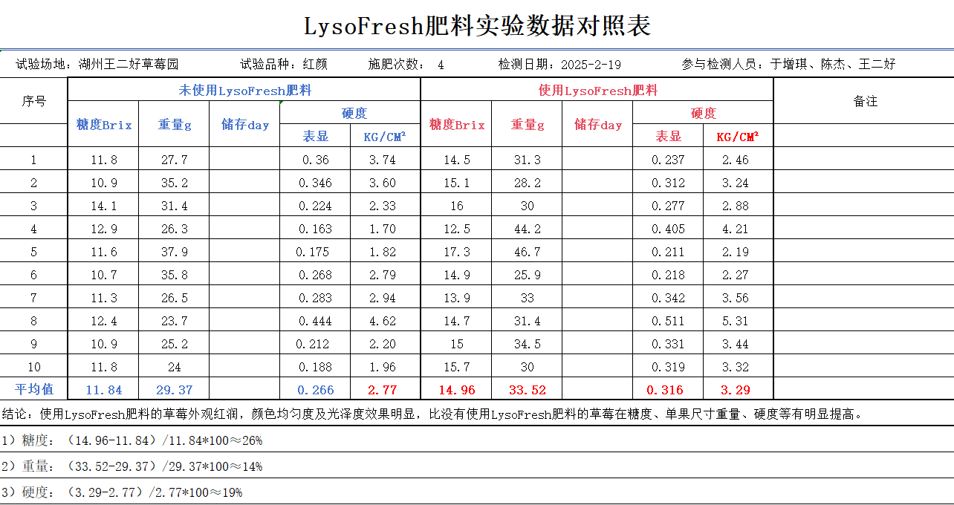
Detailed Test Result Sheet
NUTRA-PARK
Location: Wang Erhao Strawberry Farm, Huzhou, China | Crop: Strawberry | Applications: 4 | Measurement: 2025-02-19
No. | Control Brix | Control Weight (g) | Control Firmness | FruitQ+ Brix | FruitQ+ Weight (g) | FruitQ+ Firmness
1 | 11.8 | 27.7 | 3.74 | 14.5 | 31.3 | 2.46
2 | 10.9 | 35.2 | 3.60 | 15.1 | 28.2 | 3.24
3 | 14.1 | 31.4 | 2.33 | 16 | 30 | 2.88
4 | 12.9 | 26.3 | 1.70 | 12.5 | 44.2 | 4.21
5 | 11.6 | 37.9 | 1.82 | 17.3 | 46.7 | 2.19
6 | 10.7 | 35.8 | 2.79 | 14.9 | 25.9 | 2.27
7 | 11.3 | 26.5 | 2.94 | 13.9 | 33 | 3.56
8 | 12.4 | 23.7 | 4.62 | 14.7 | 31.4 | 5.31
9 | 10.9 | 25.2 | 2.20 | 15 | 34.5 | 3.44
10 | 11.8 | 24 | 1.96 | 15.7 | 30 | 3.32
Average | 11.84 | 29.37 | 2.77 | 14.96 | 33.52 | 3.29
FruitQ+ vs Control: Brix +26% · Fruit weight +14% · Firmness +19%
Original trial measurements preserved; product naming standardized to FruitQ+.

Slide 5
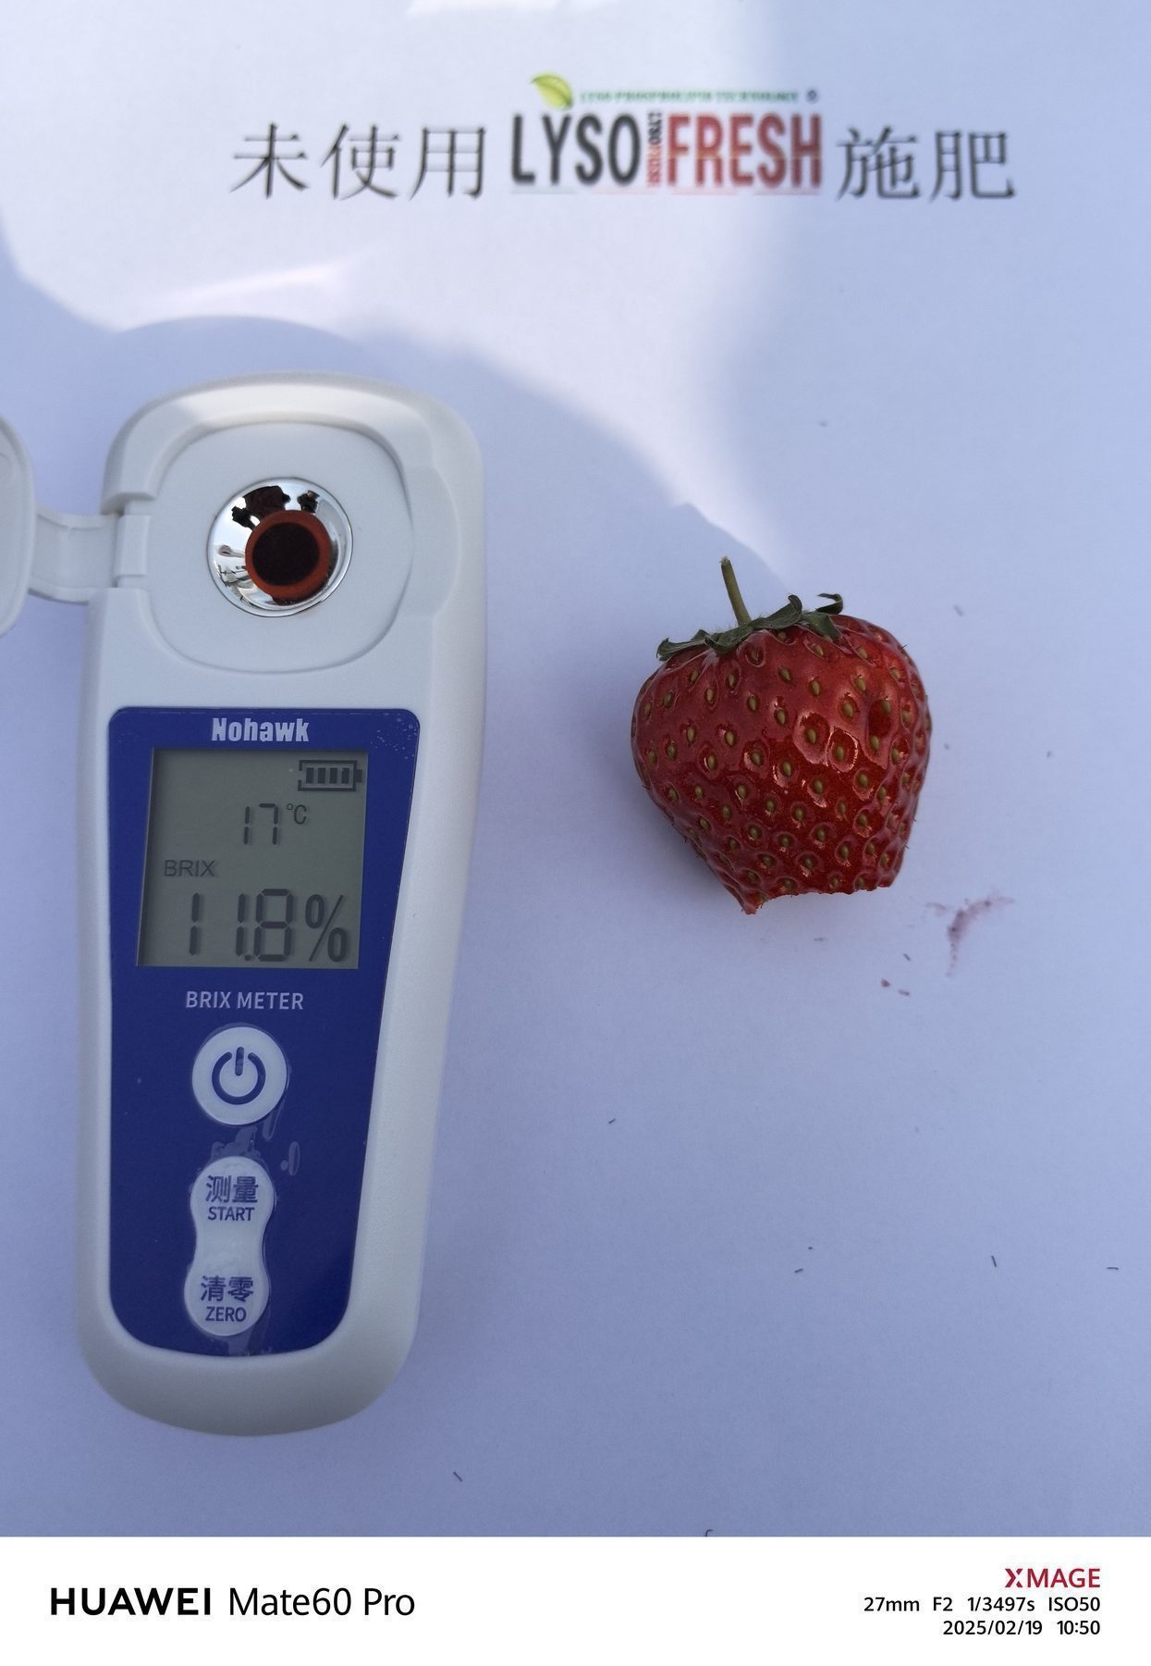
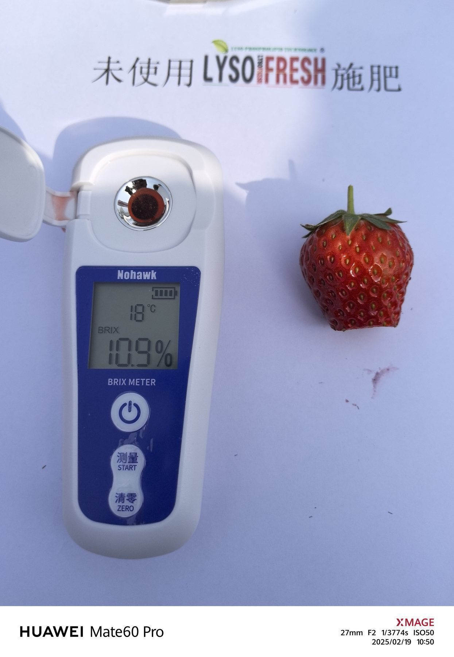
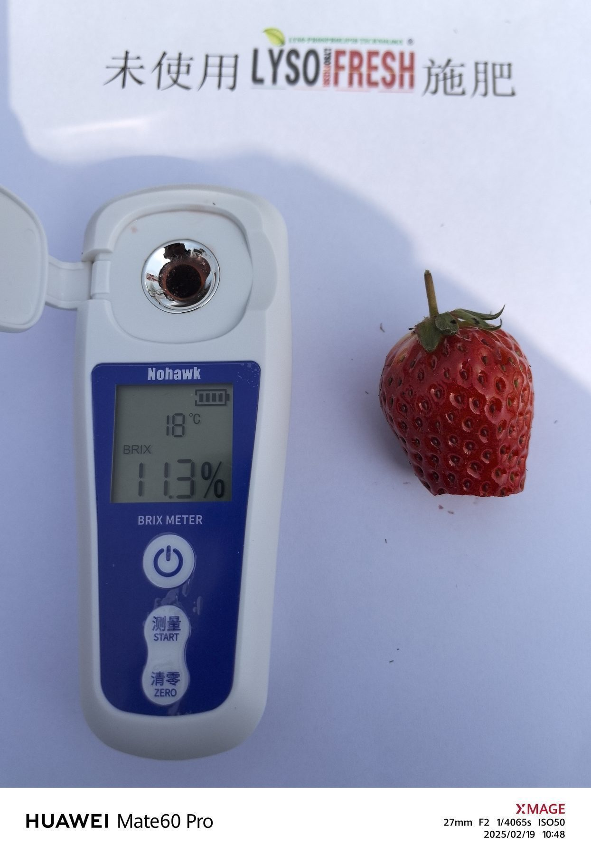
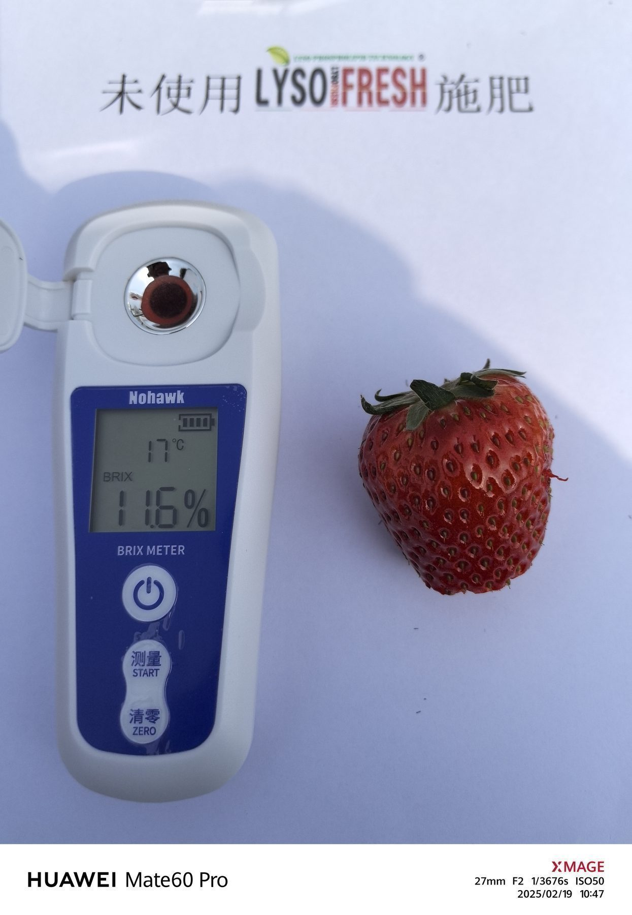
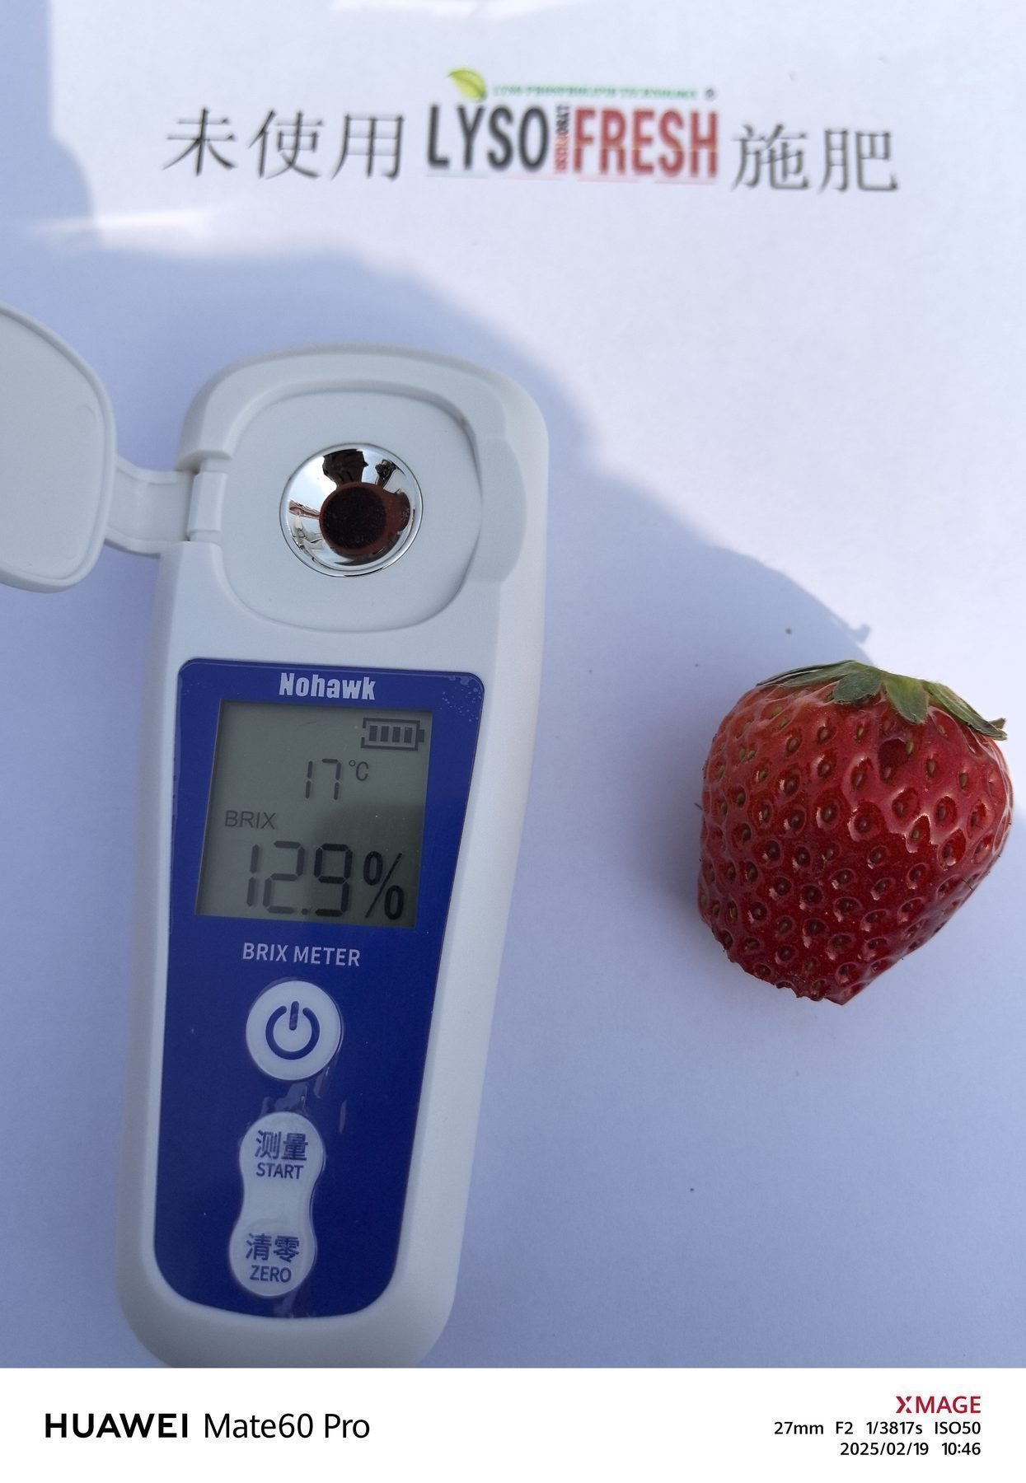
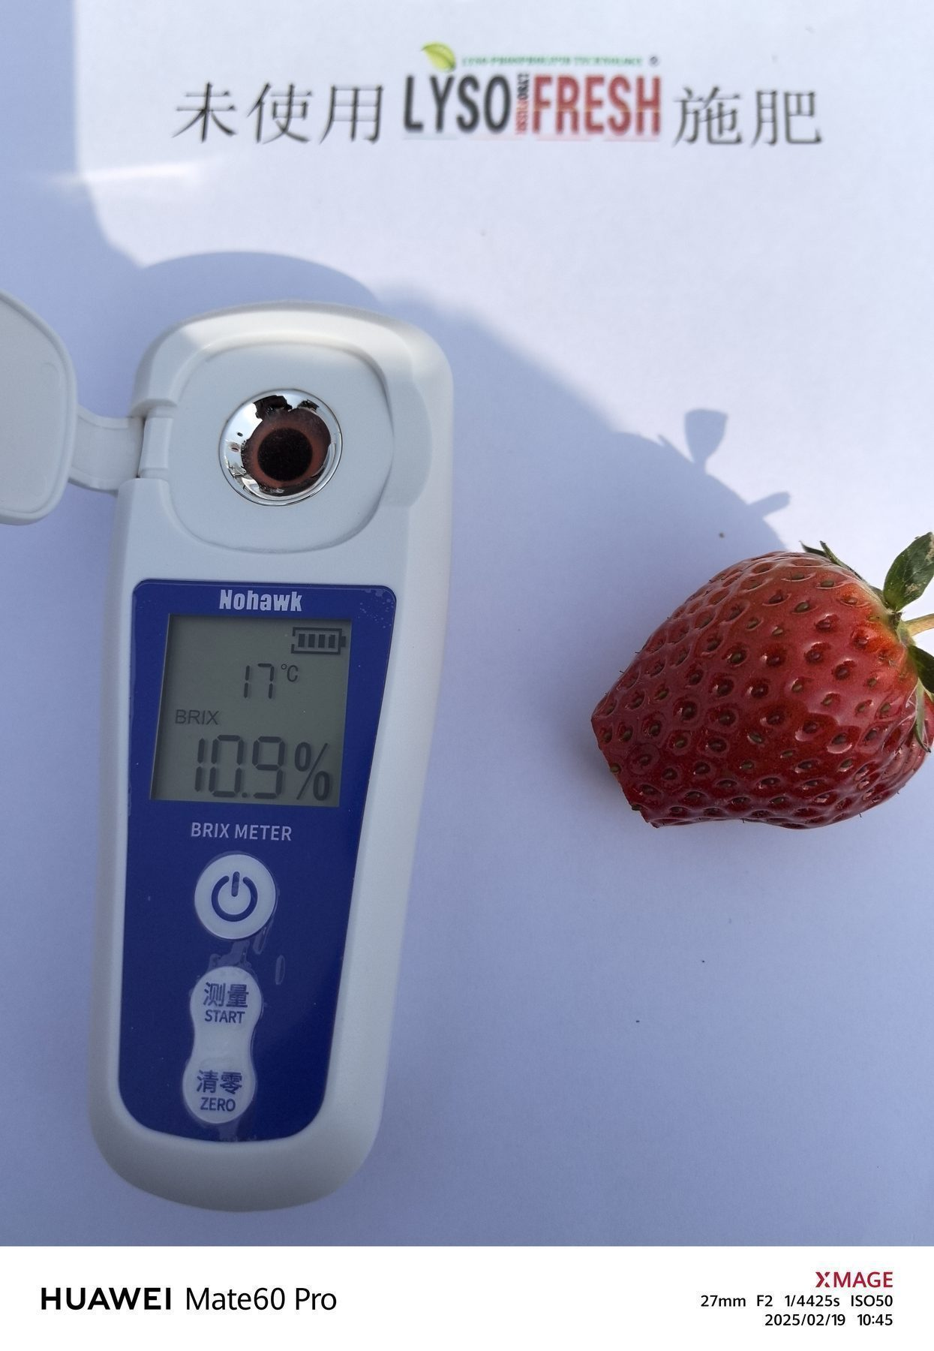
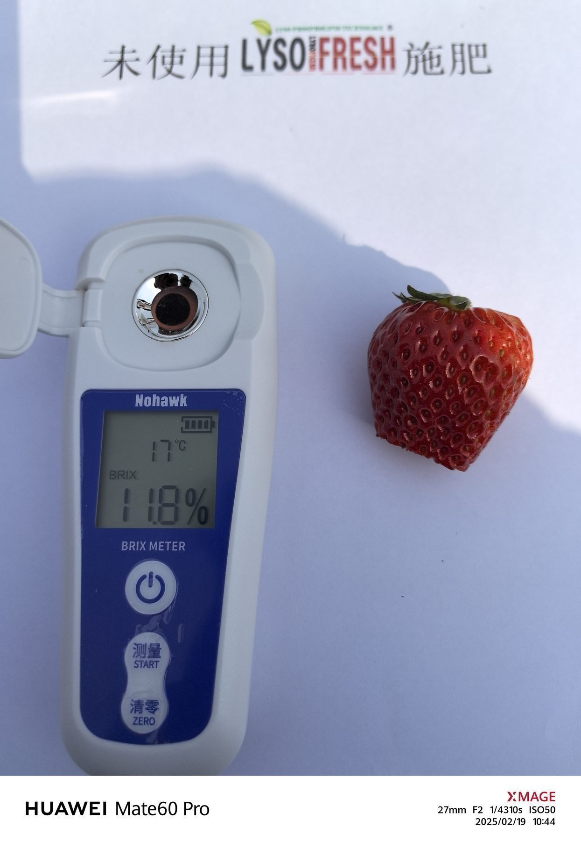
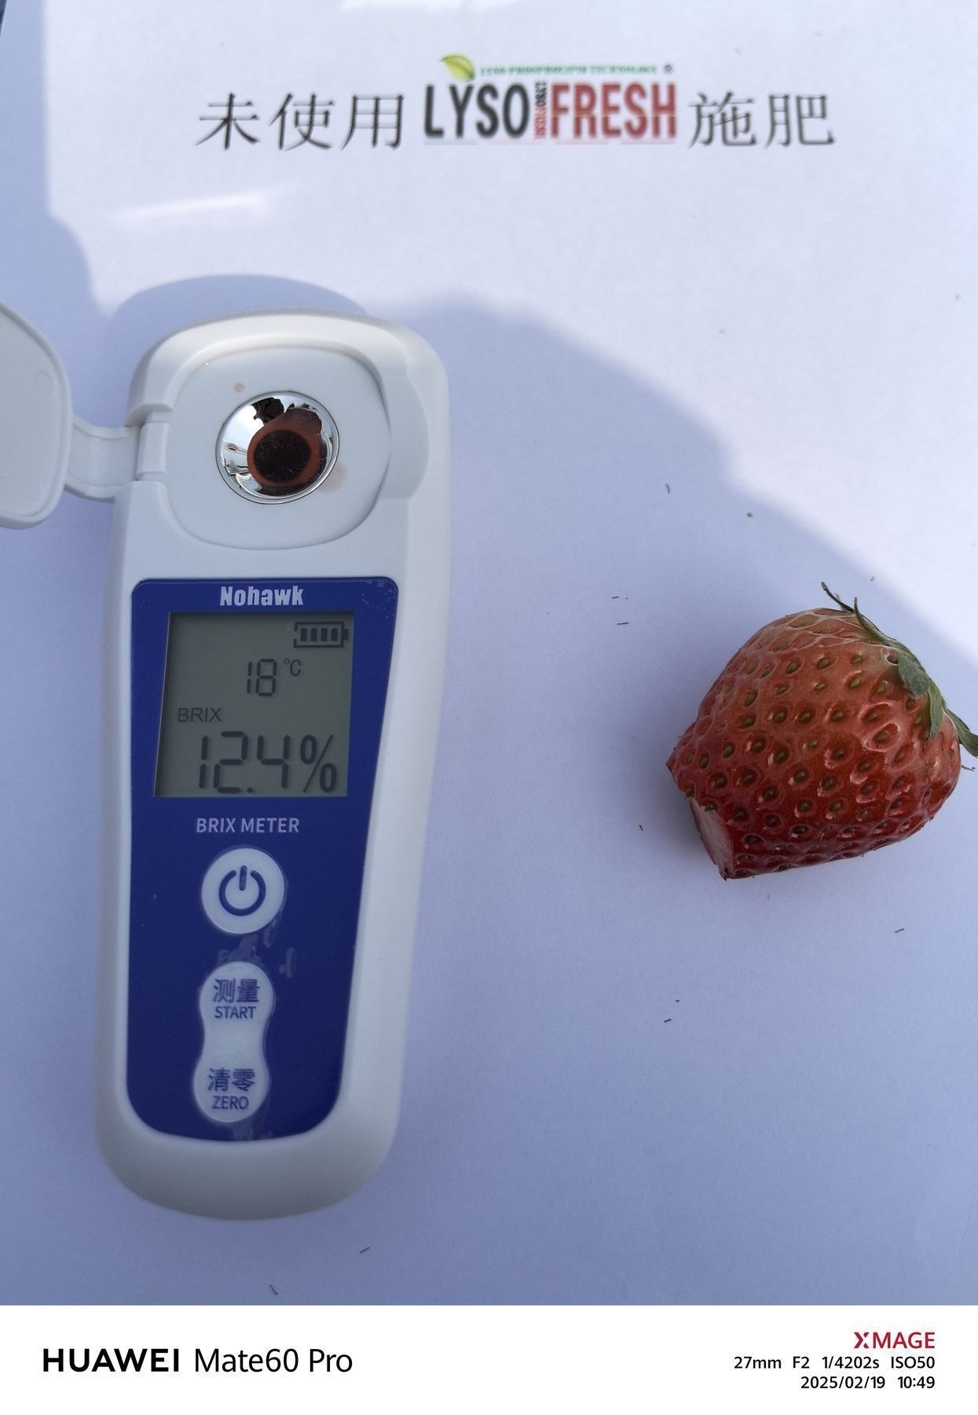
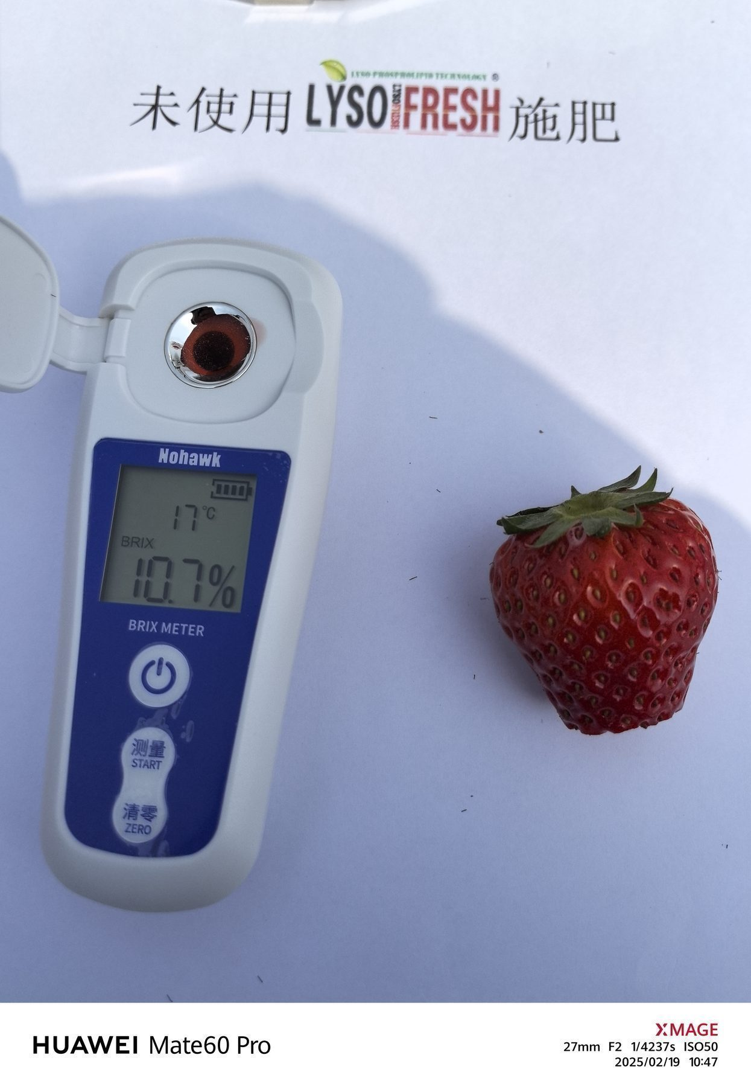
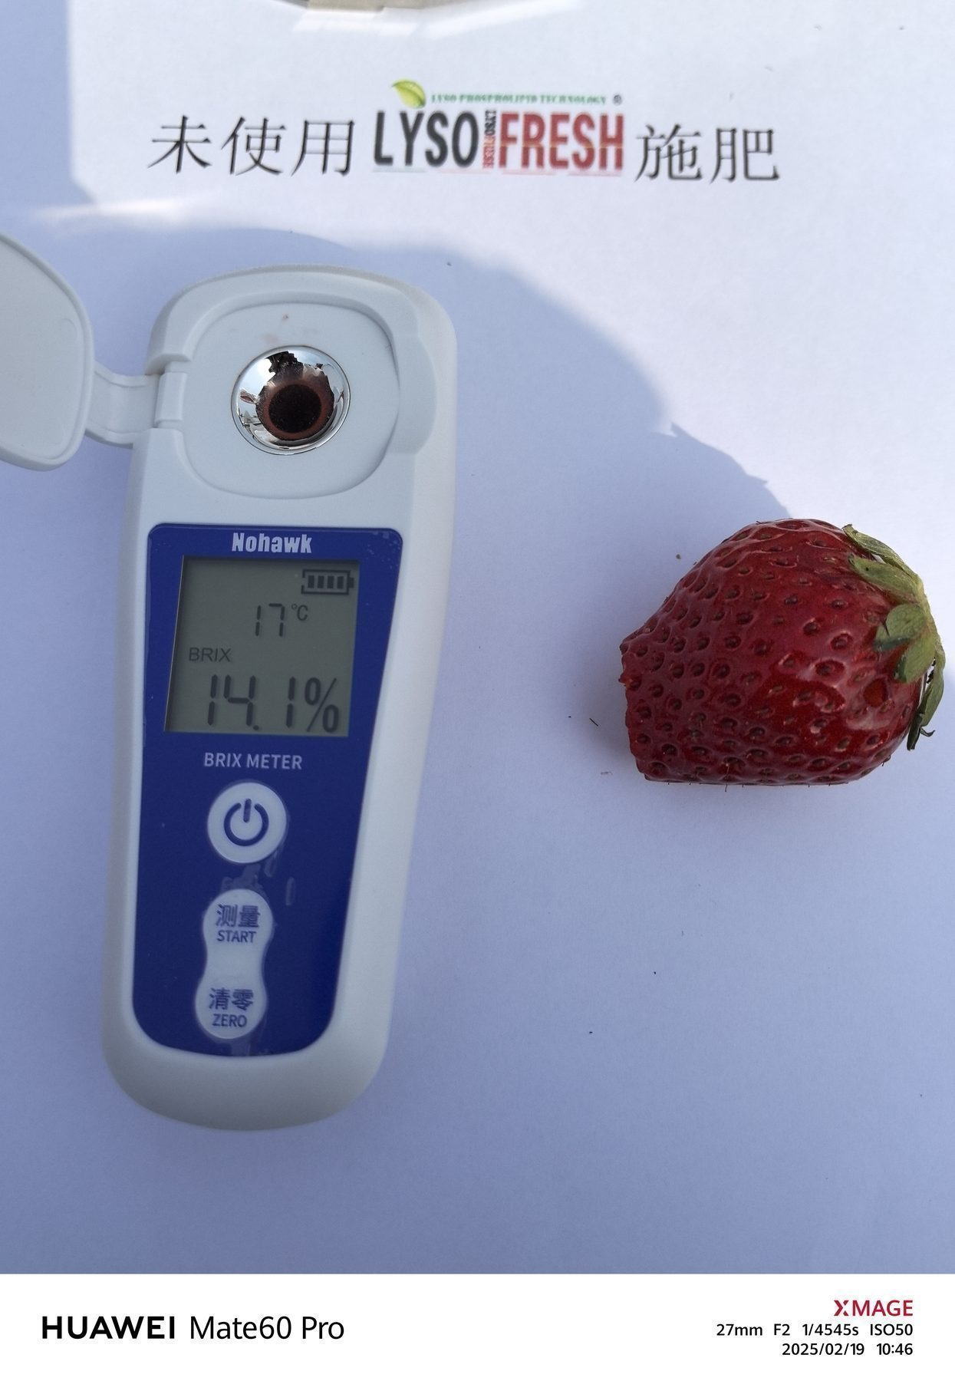
Test Results –Photo of sugar content measurement
Measurement Date：2025-2-19
CONTROL
CONTROL
CONTROL
CONTROL
CONTROL
CONTROL
CONTROL
CONTROL
CONTROL
CONTROL
CONTROL

Slide 6
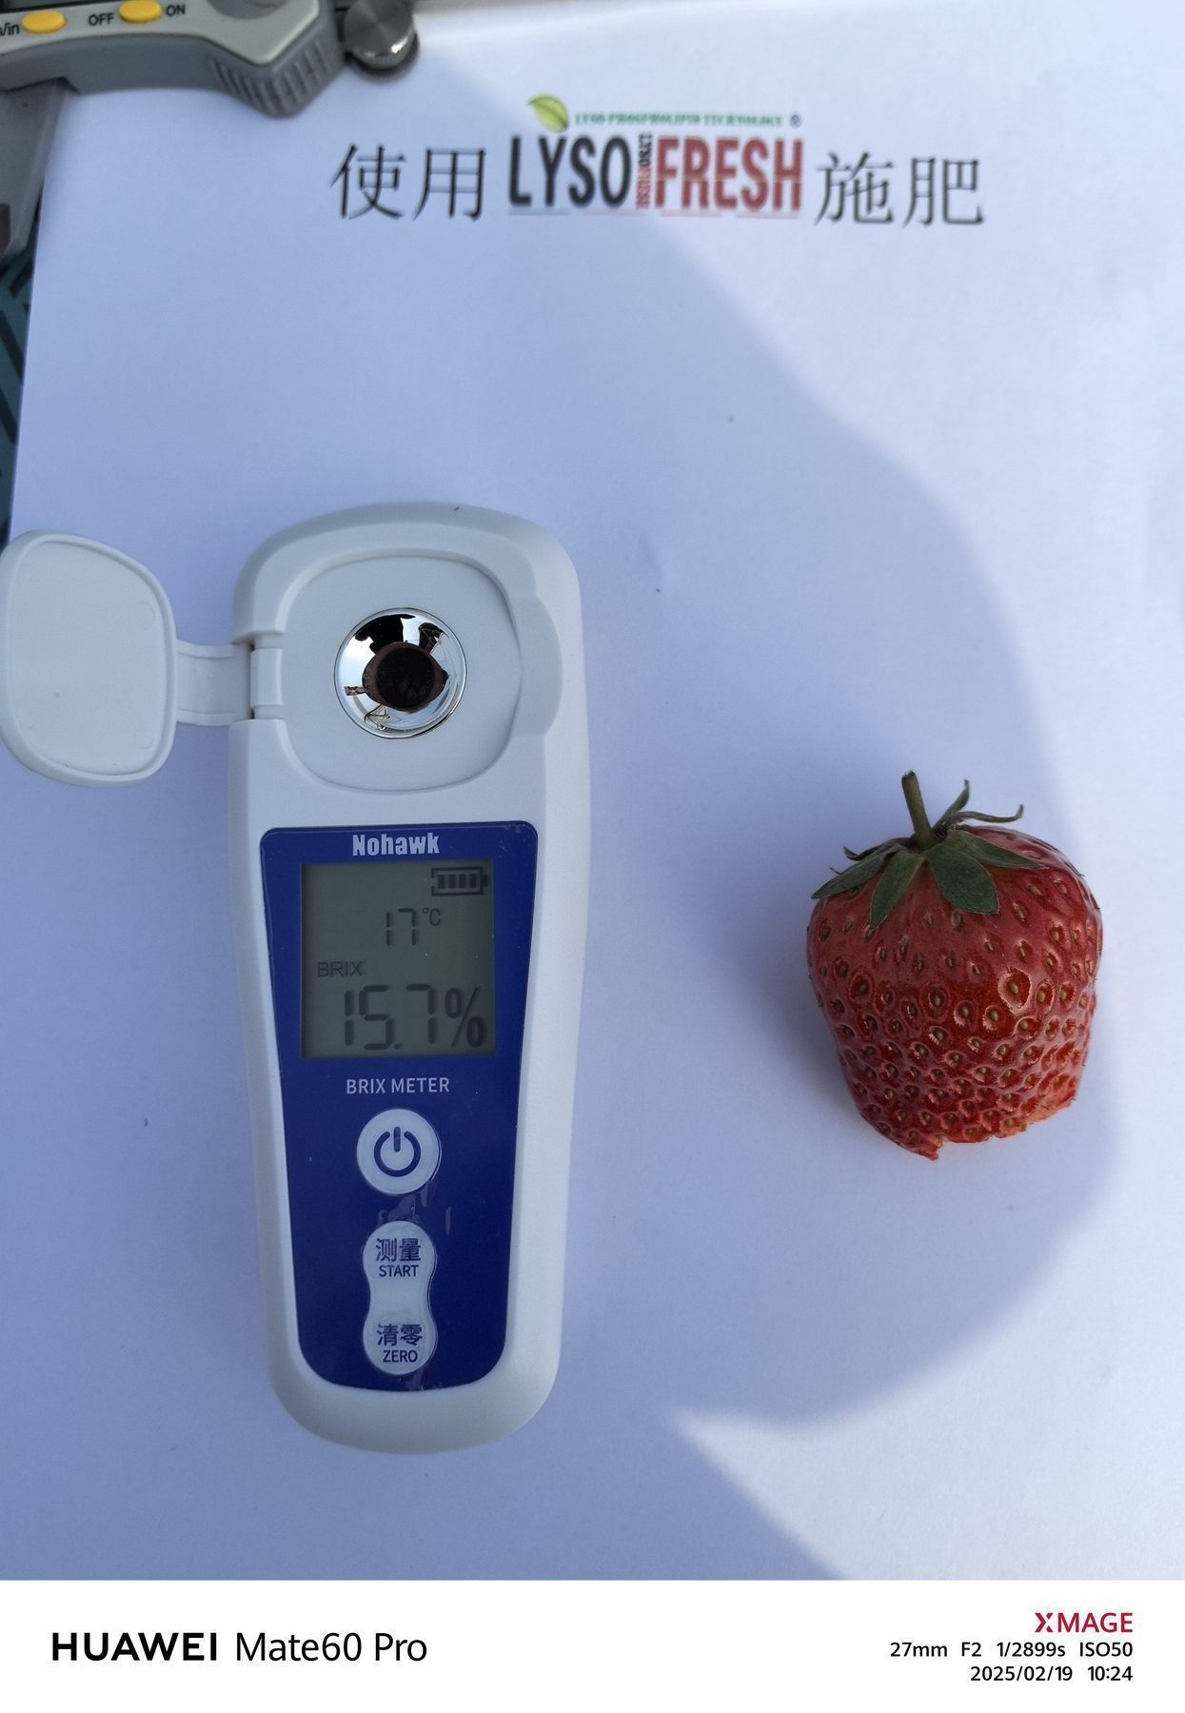
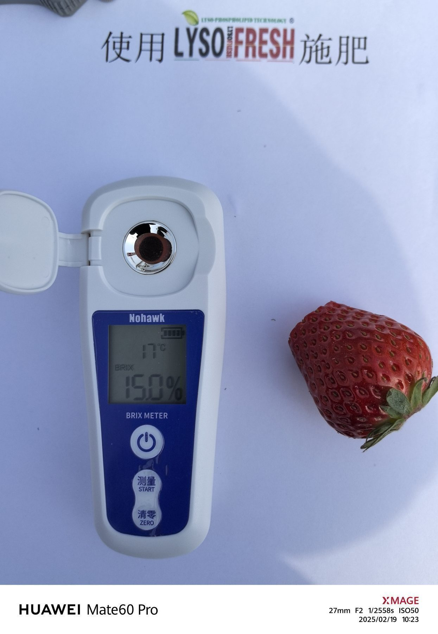
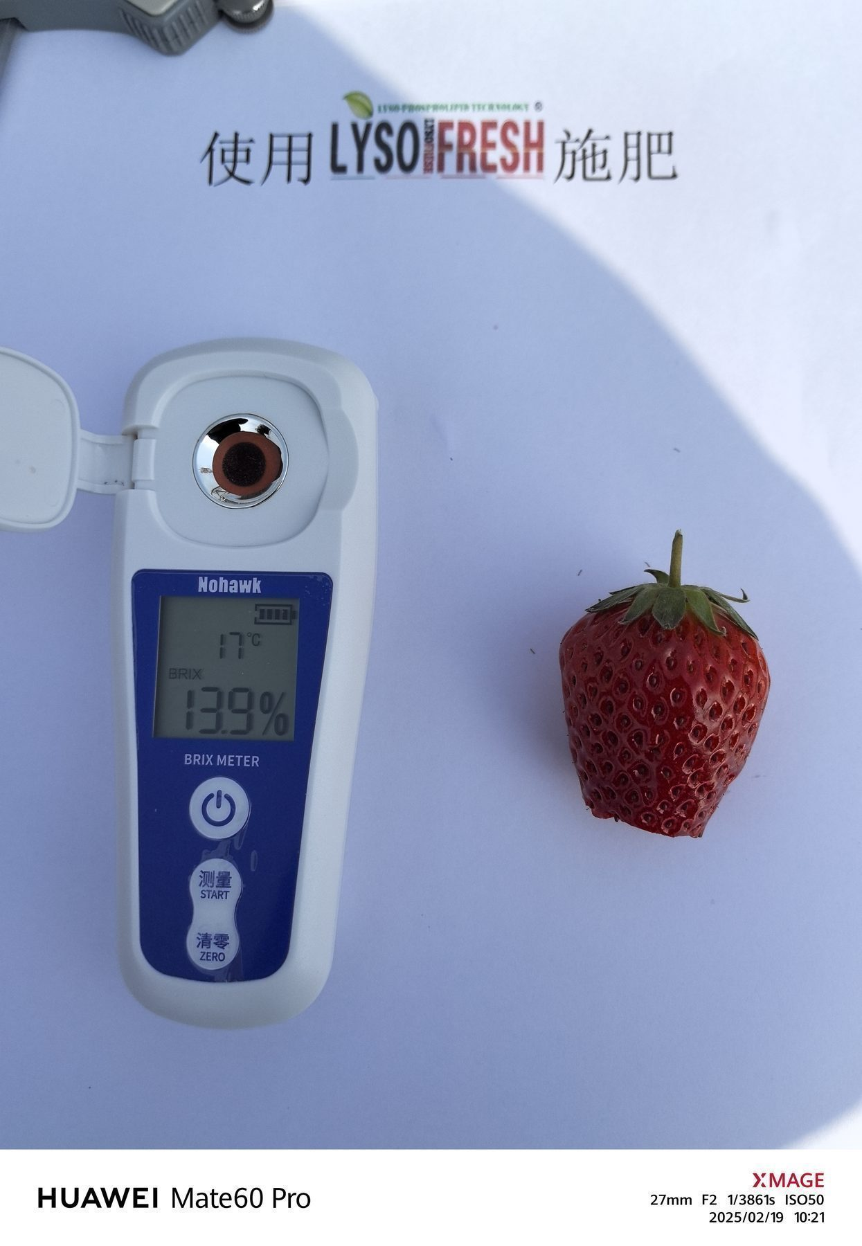
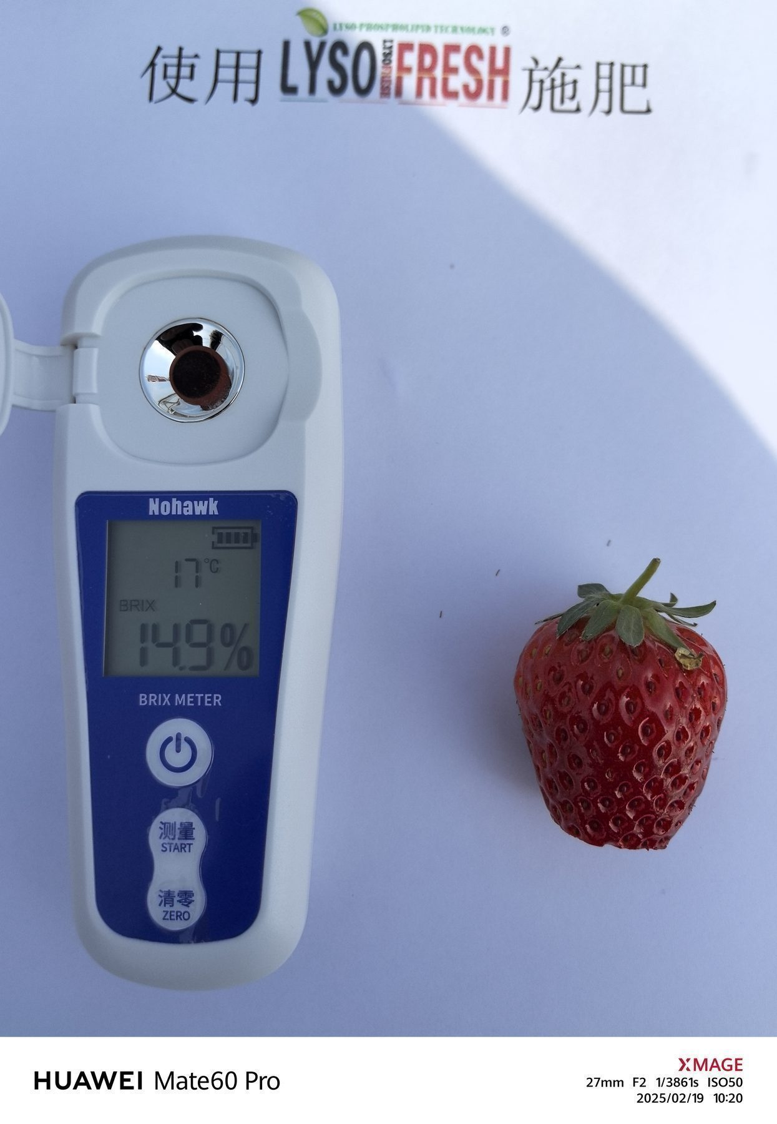
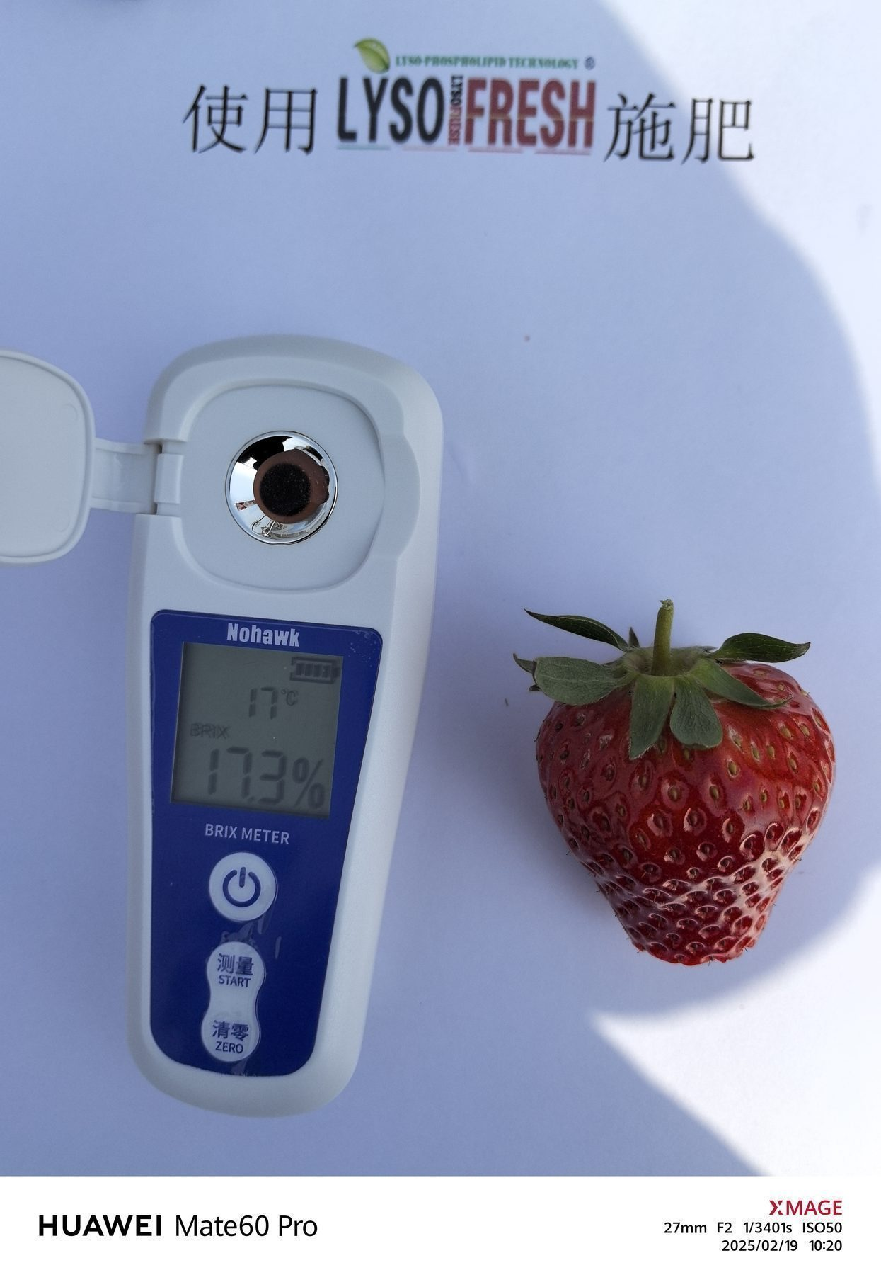
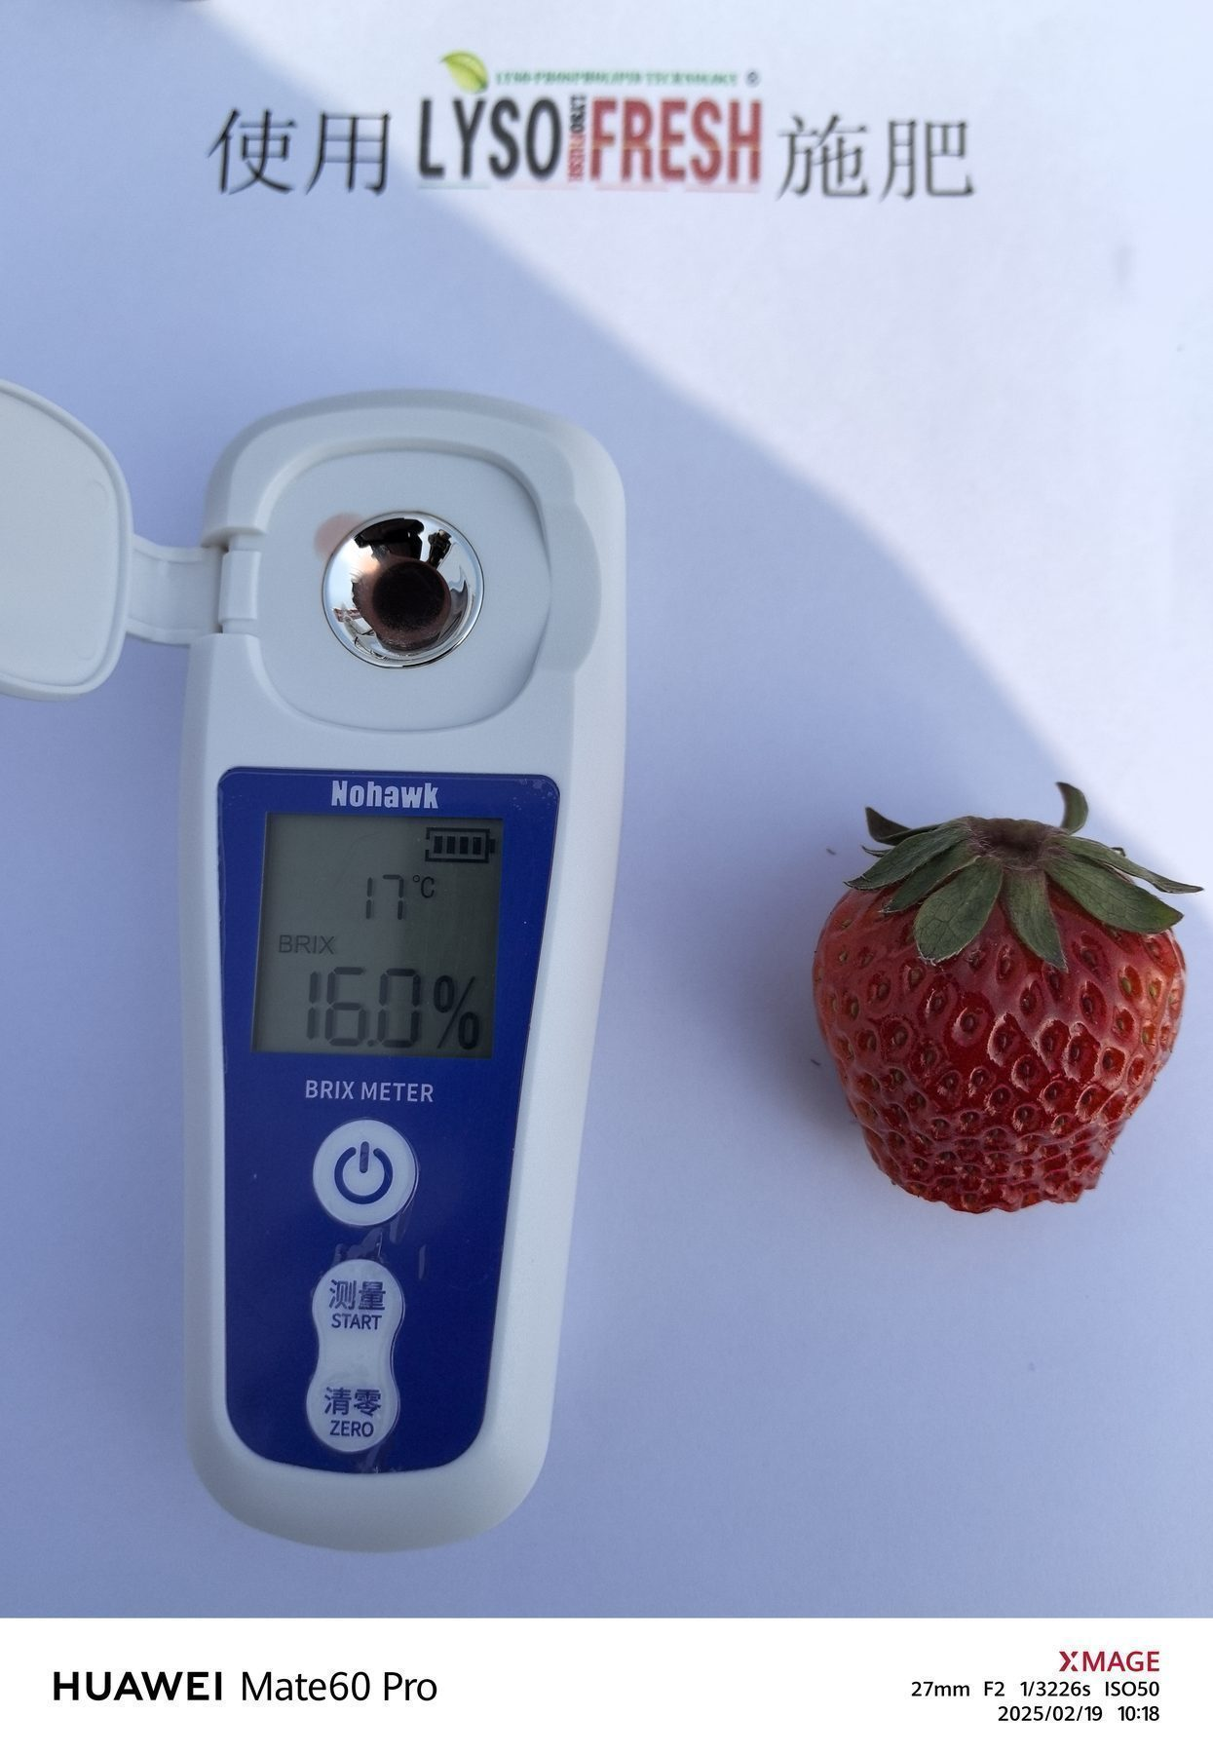
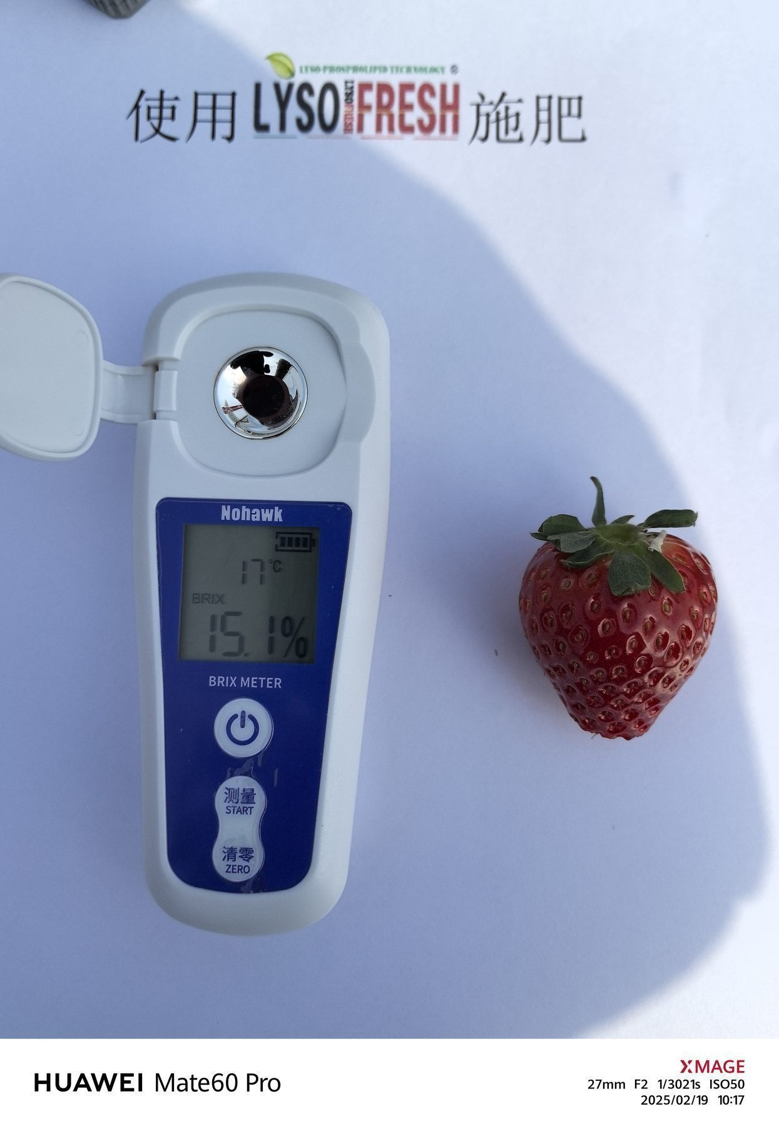
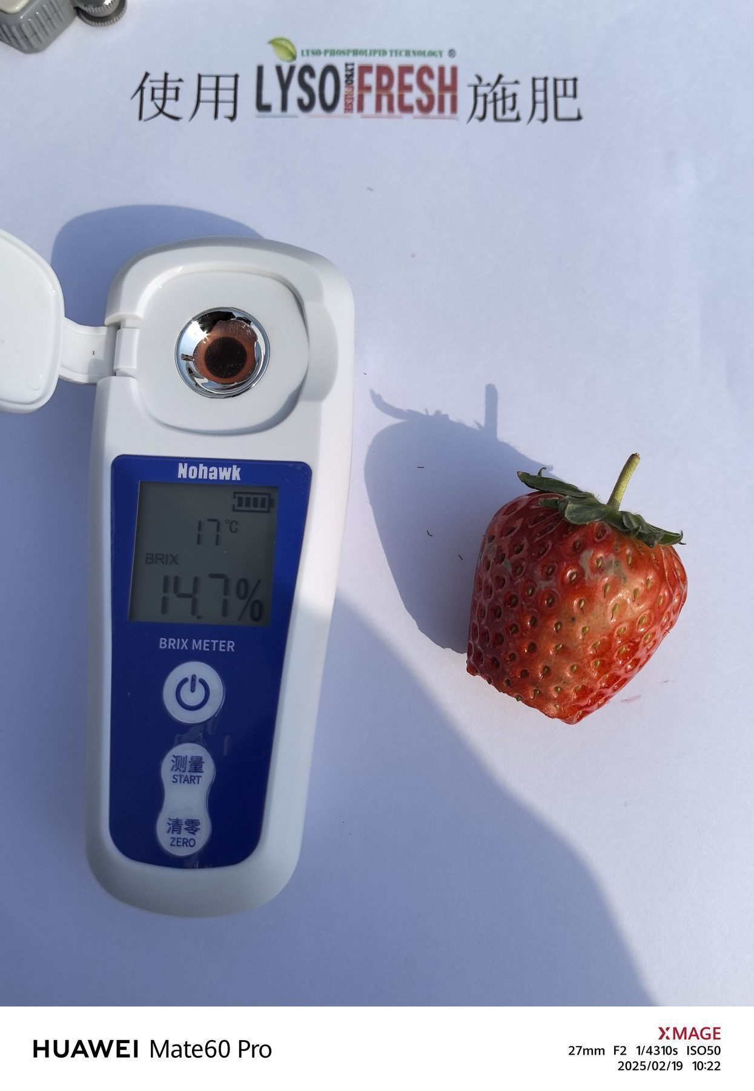
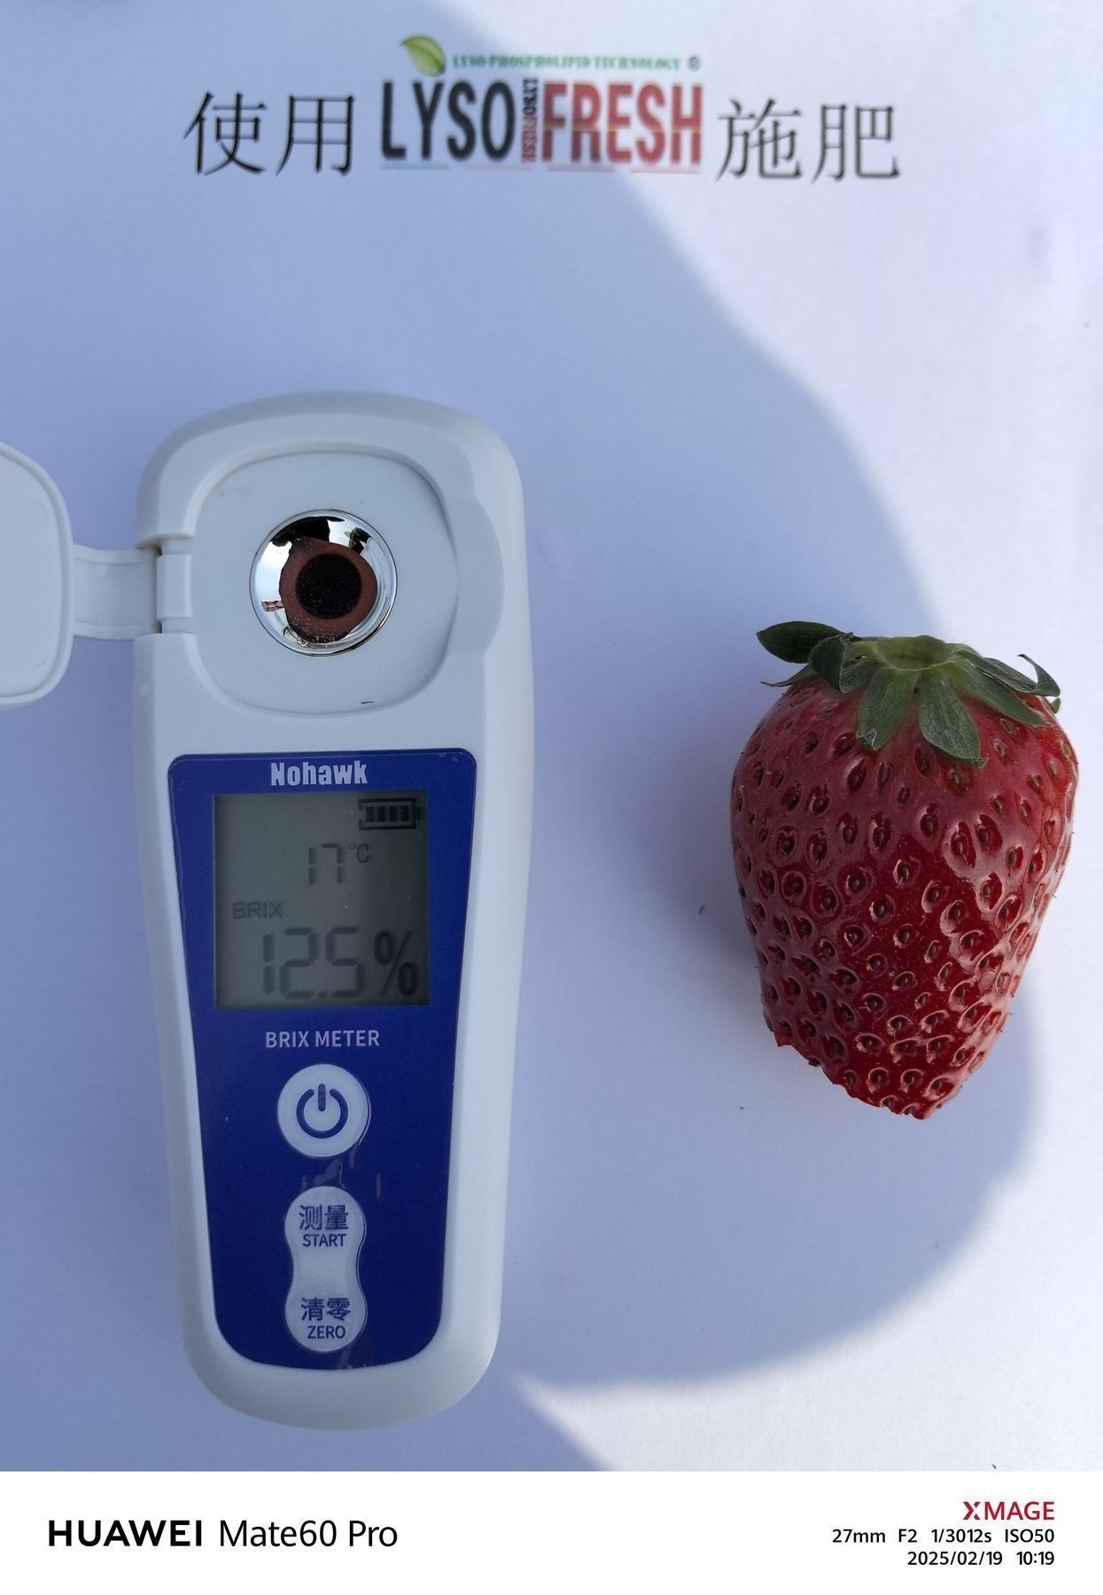
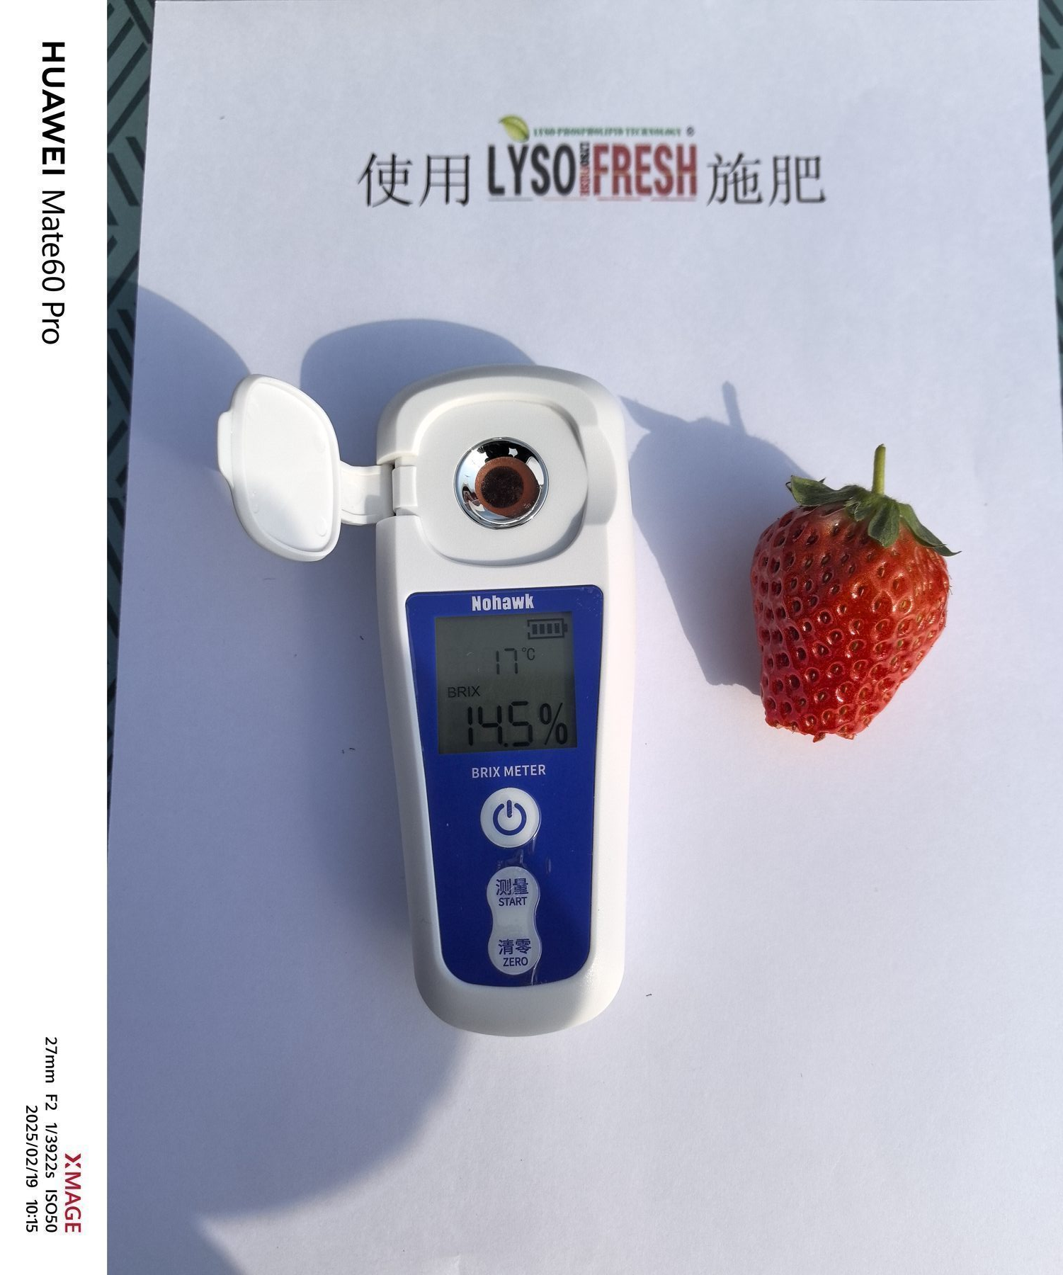
Test Results –Photo of sugar content measurement
Measurement Date：2025-2-19
FRUITQ+ TREATED
FRUITQ+
FRUITQ+
FRUITQ+
FRUITQ+
FRUITQ+
FRUITQ+
FRUITQ+
FRUITQ+
FRUITQ+
FRUITQ+

Slide 7
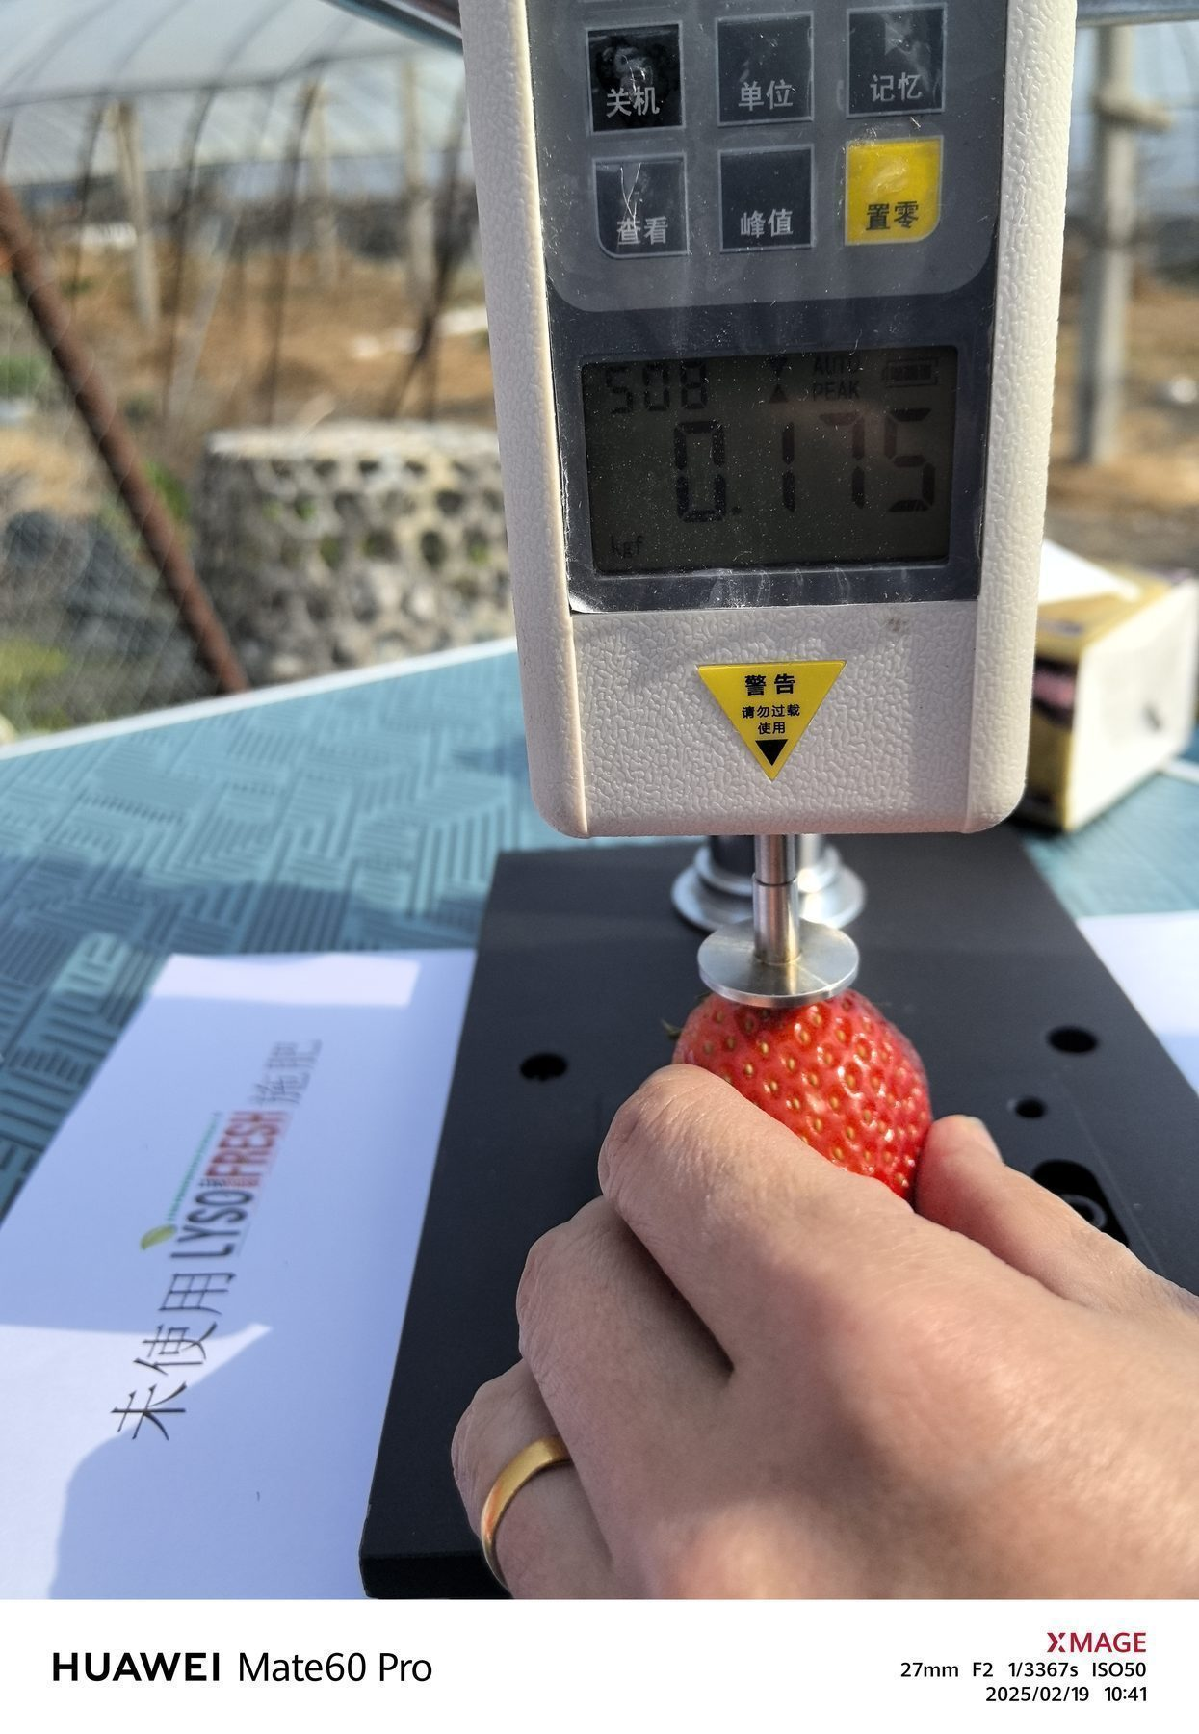
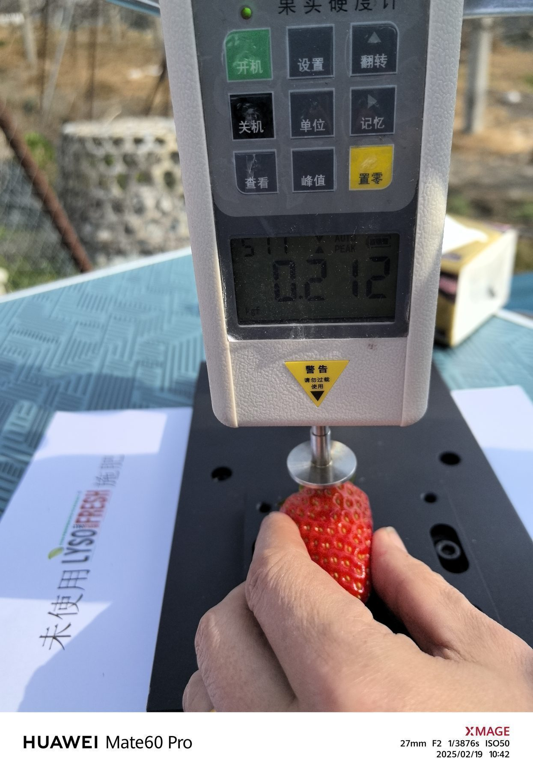
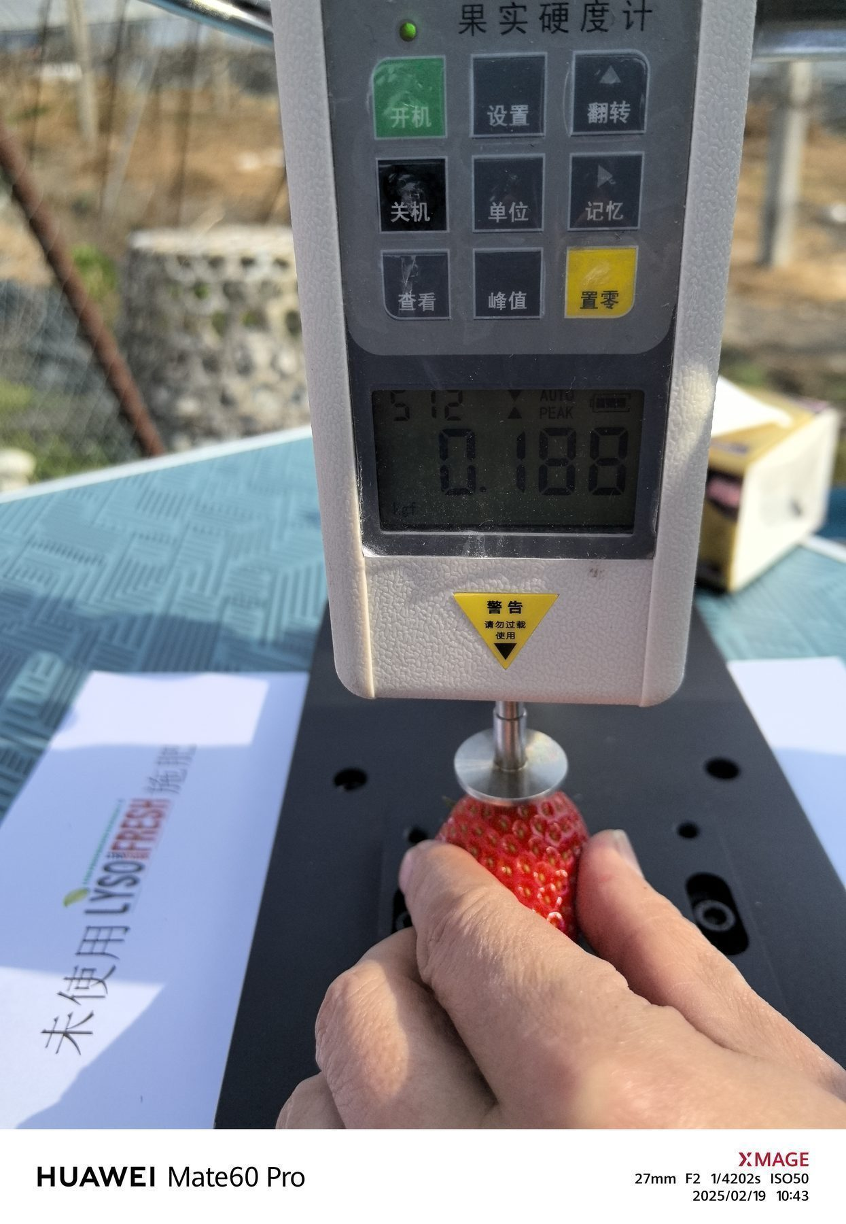
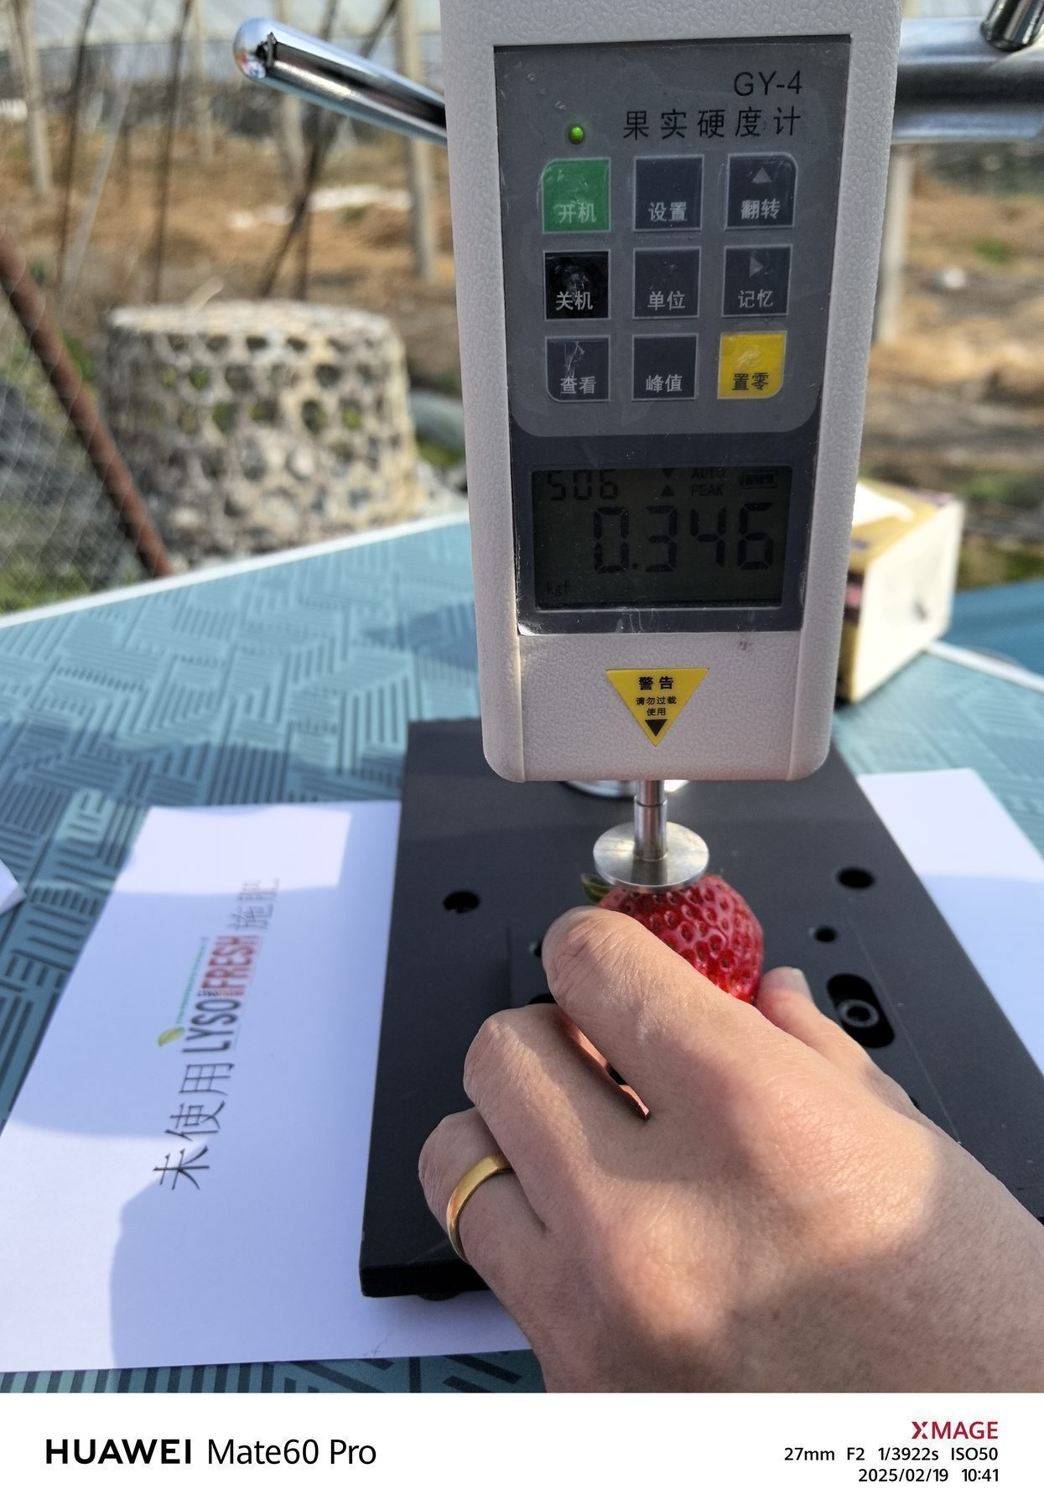
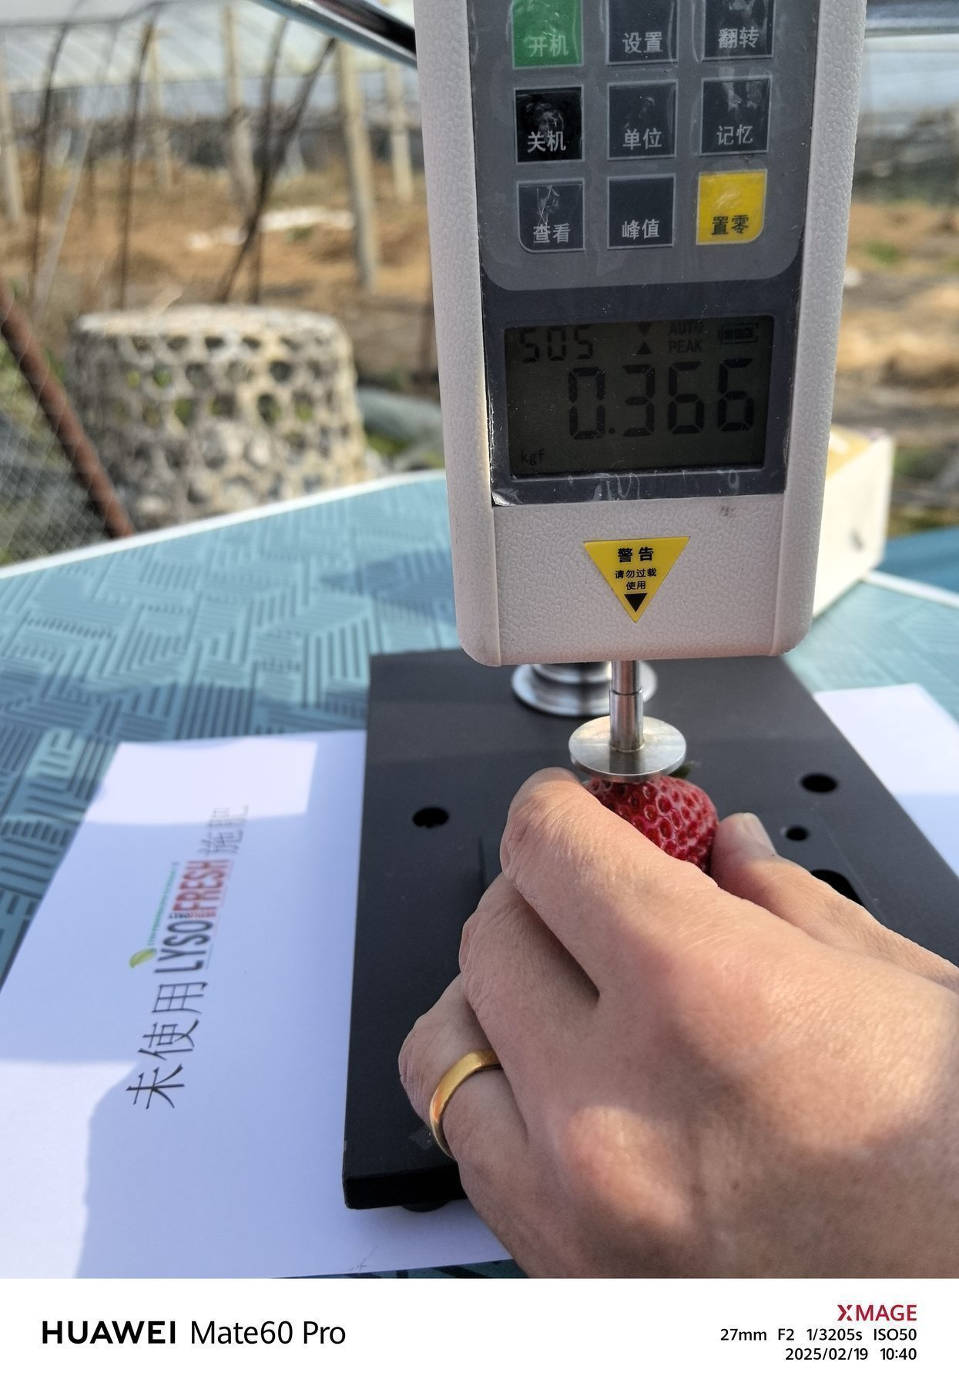
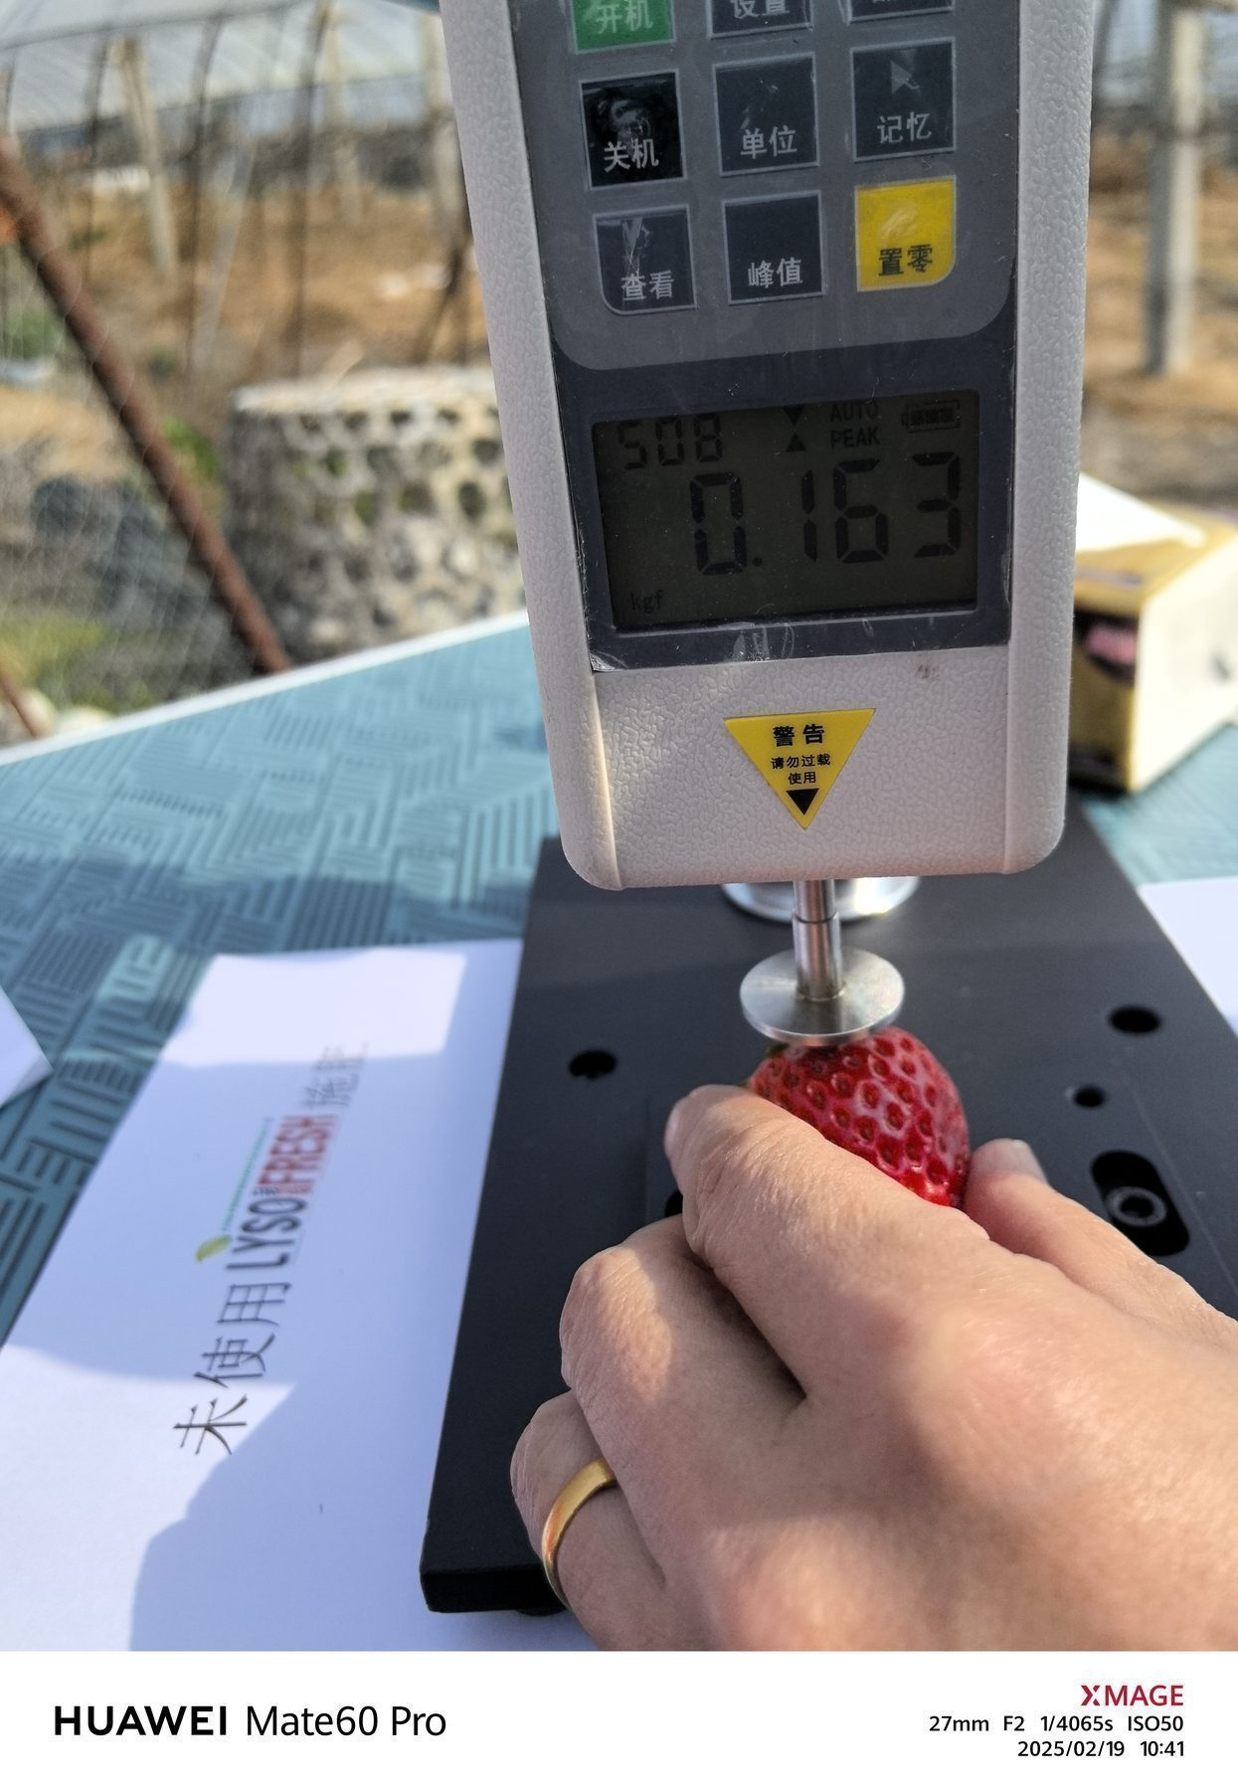
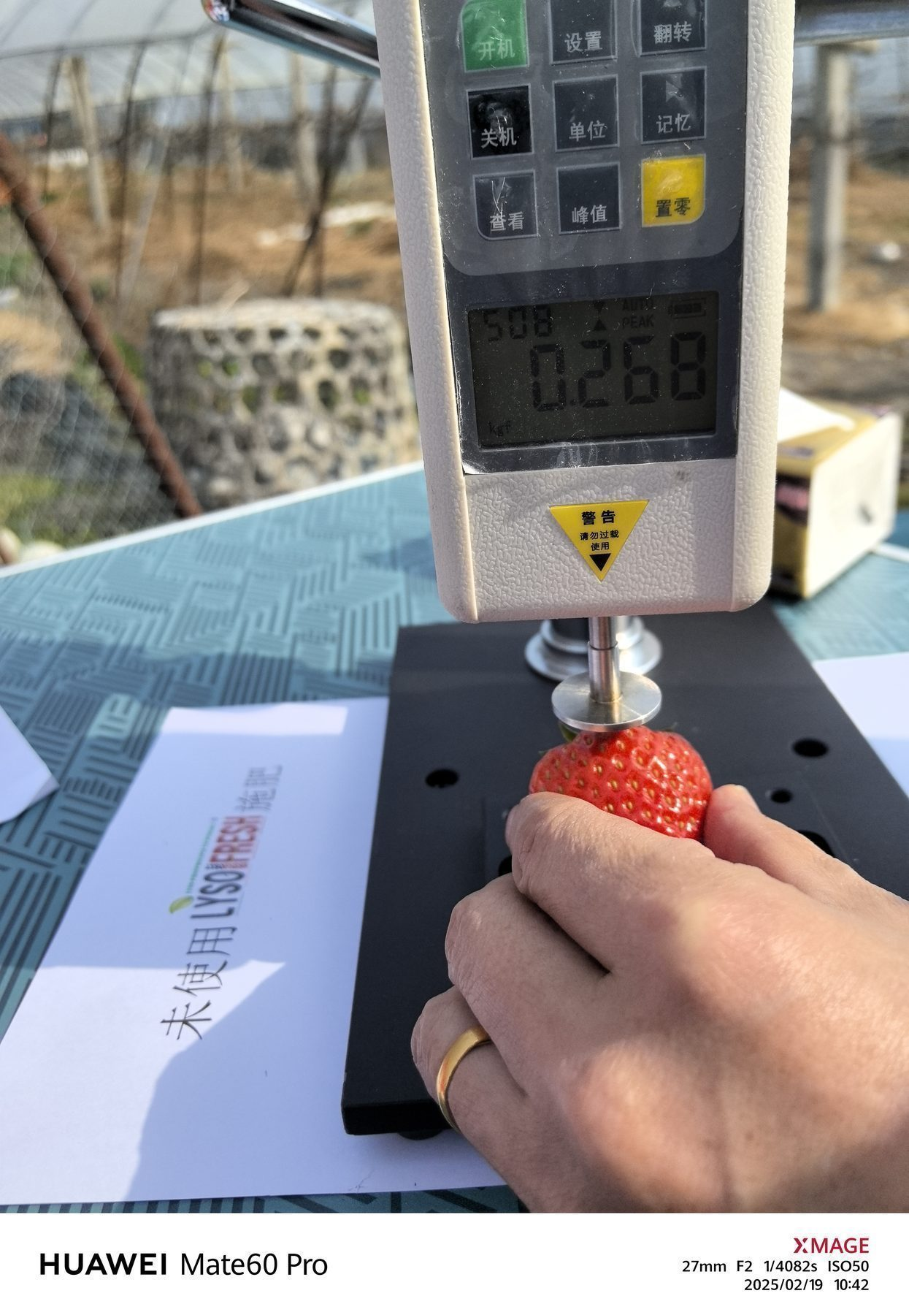
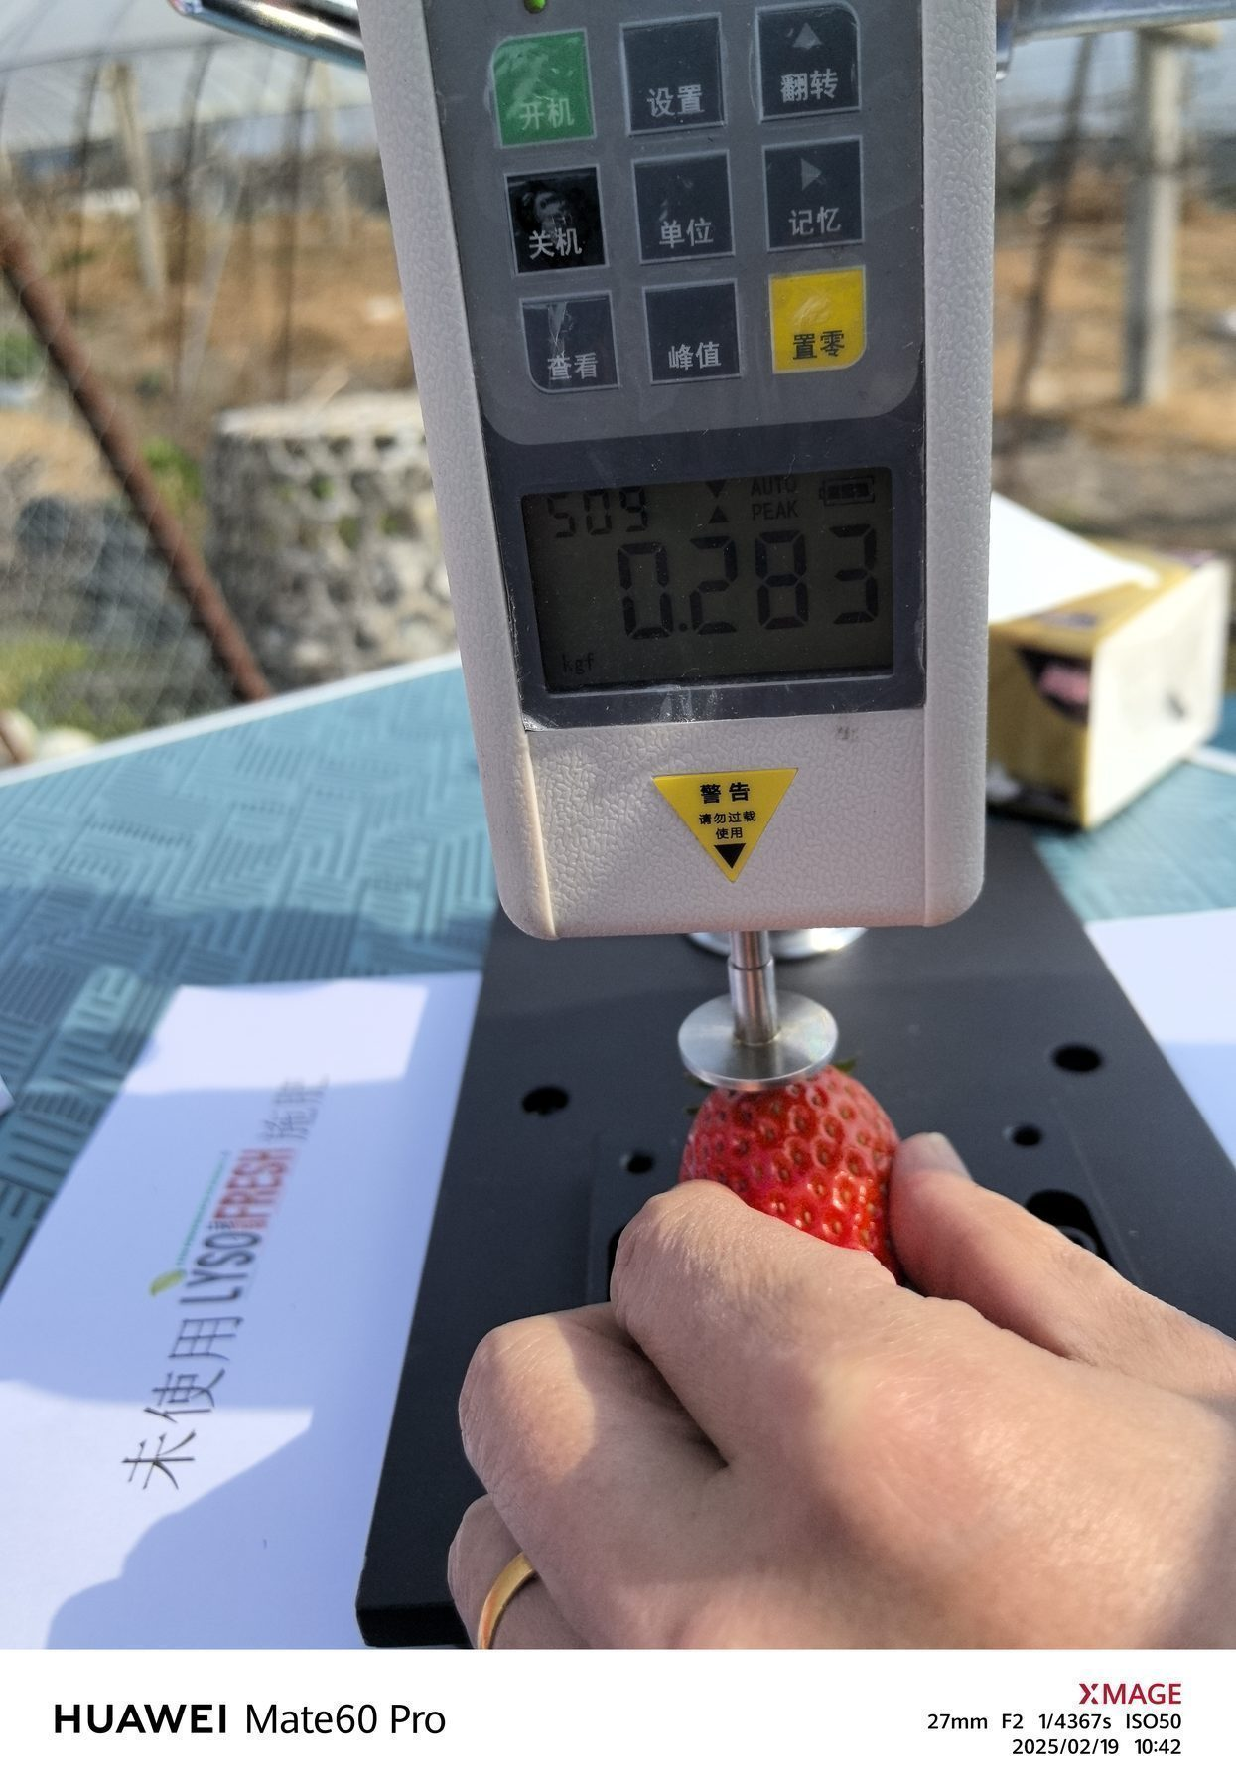
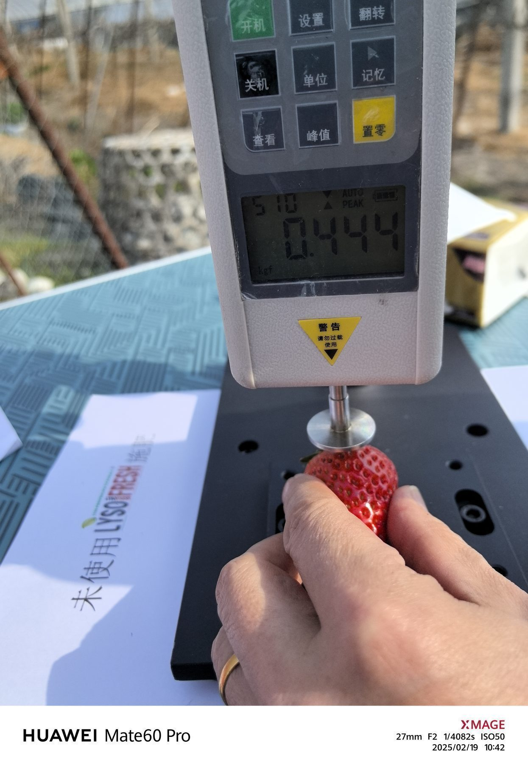
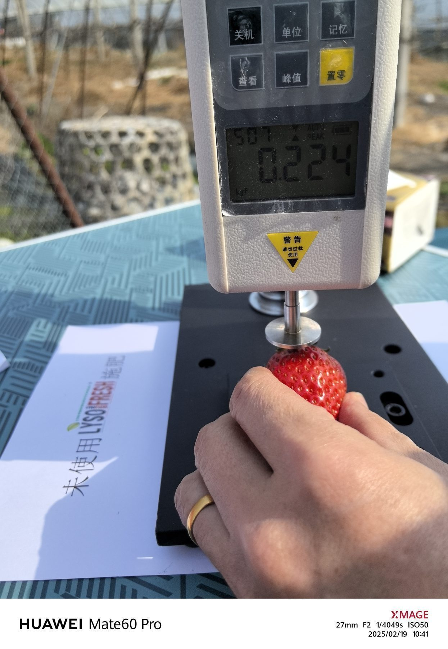
Test Results –Photo of firmness measurement
Measurement Date：2025-2-19
CONTROL
CONTROL
CONTROL
CONTROL
CONTROL
CONTROL
CONTROL
CONTROL
CONTROL
CONTROL
CONTROL

Slide 8
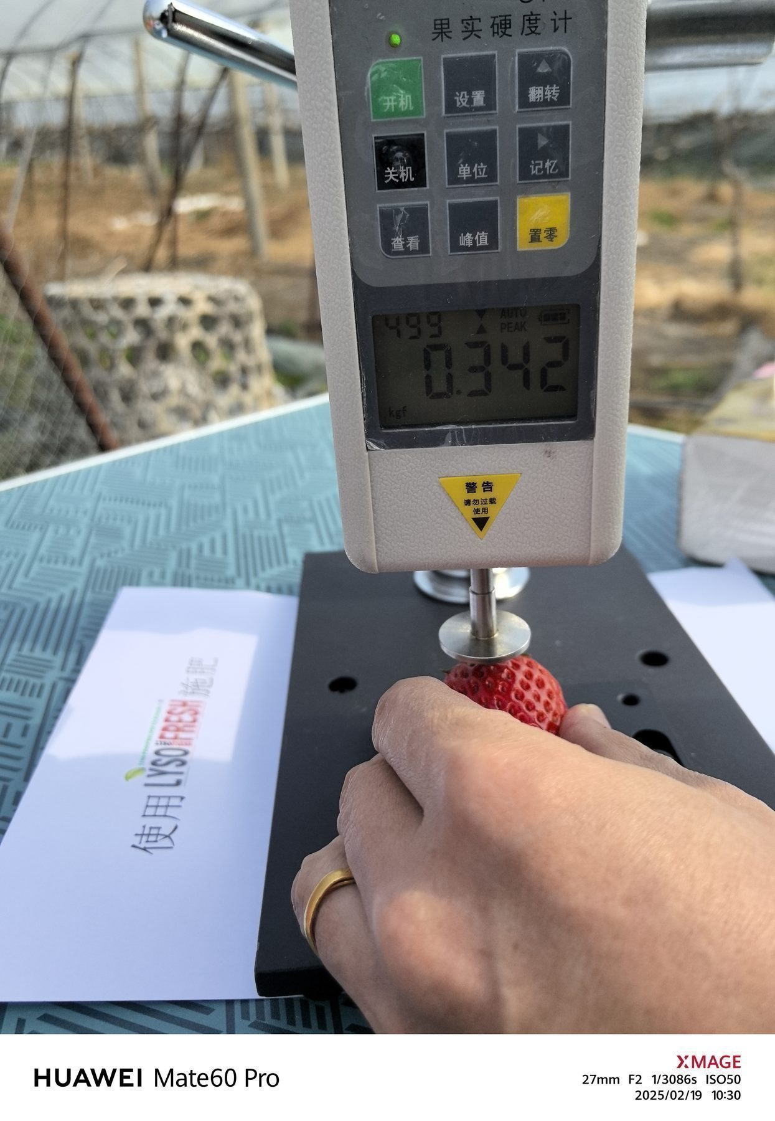
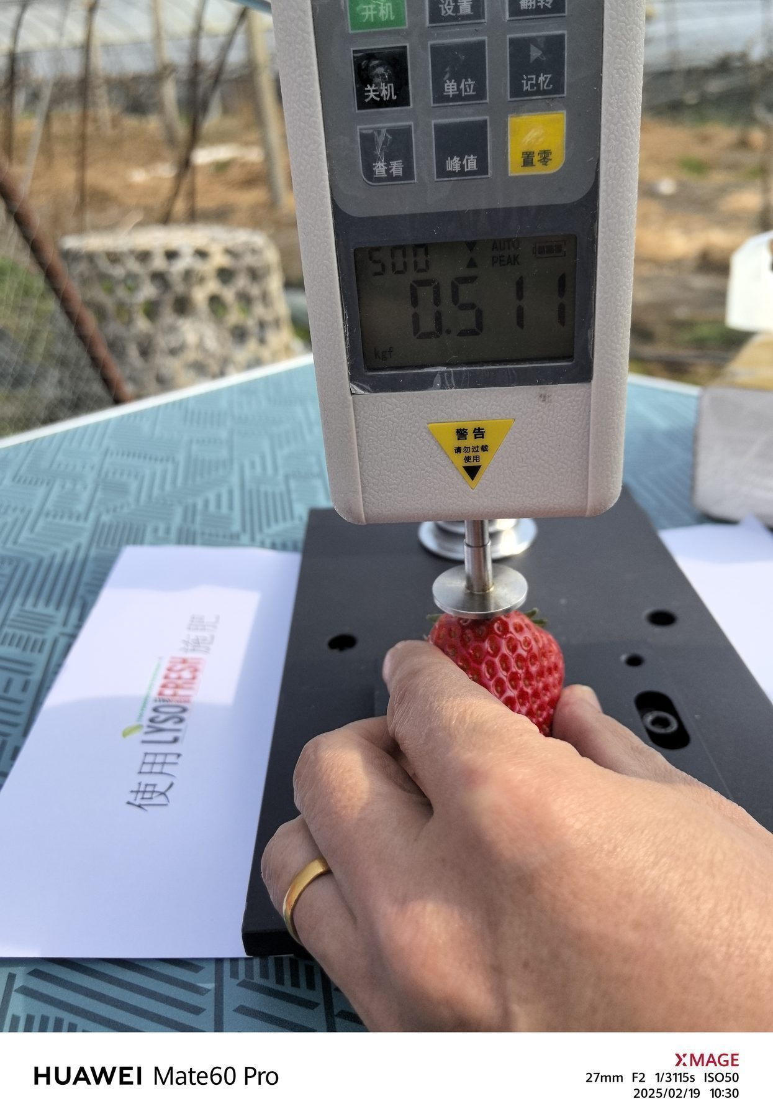
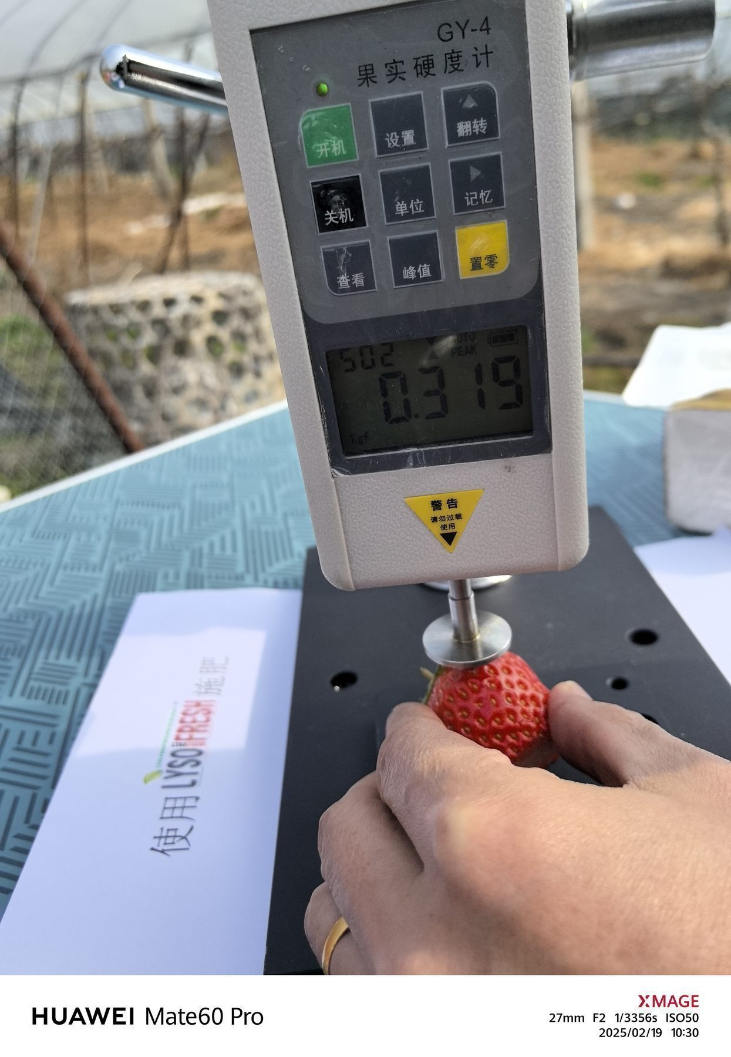
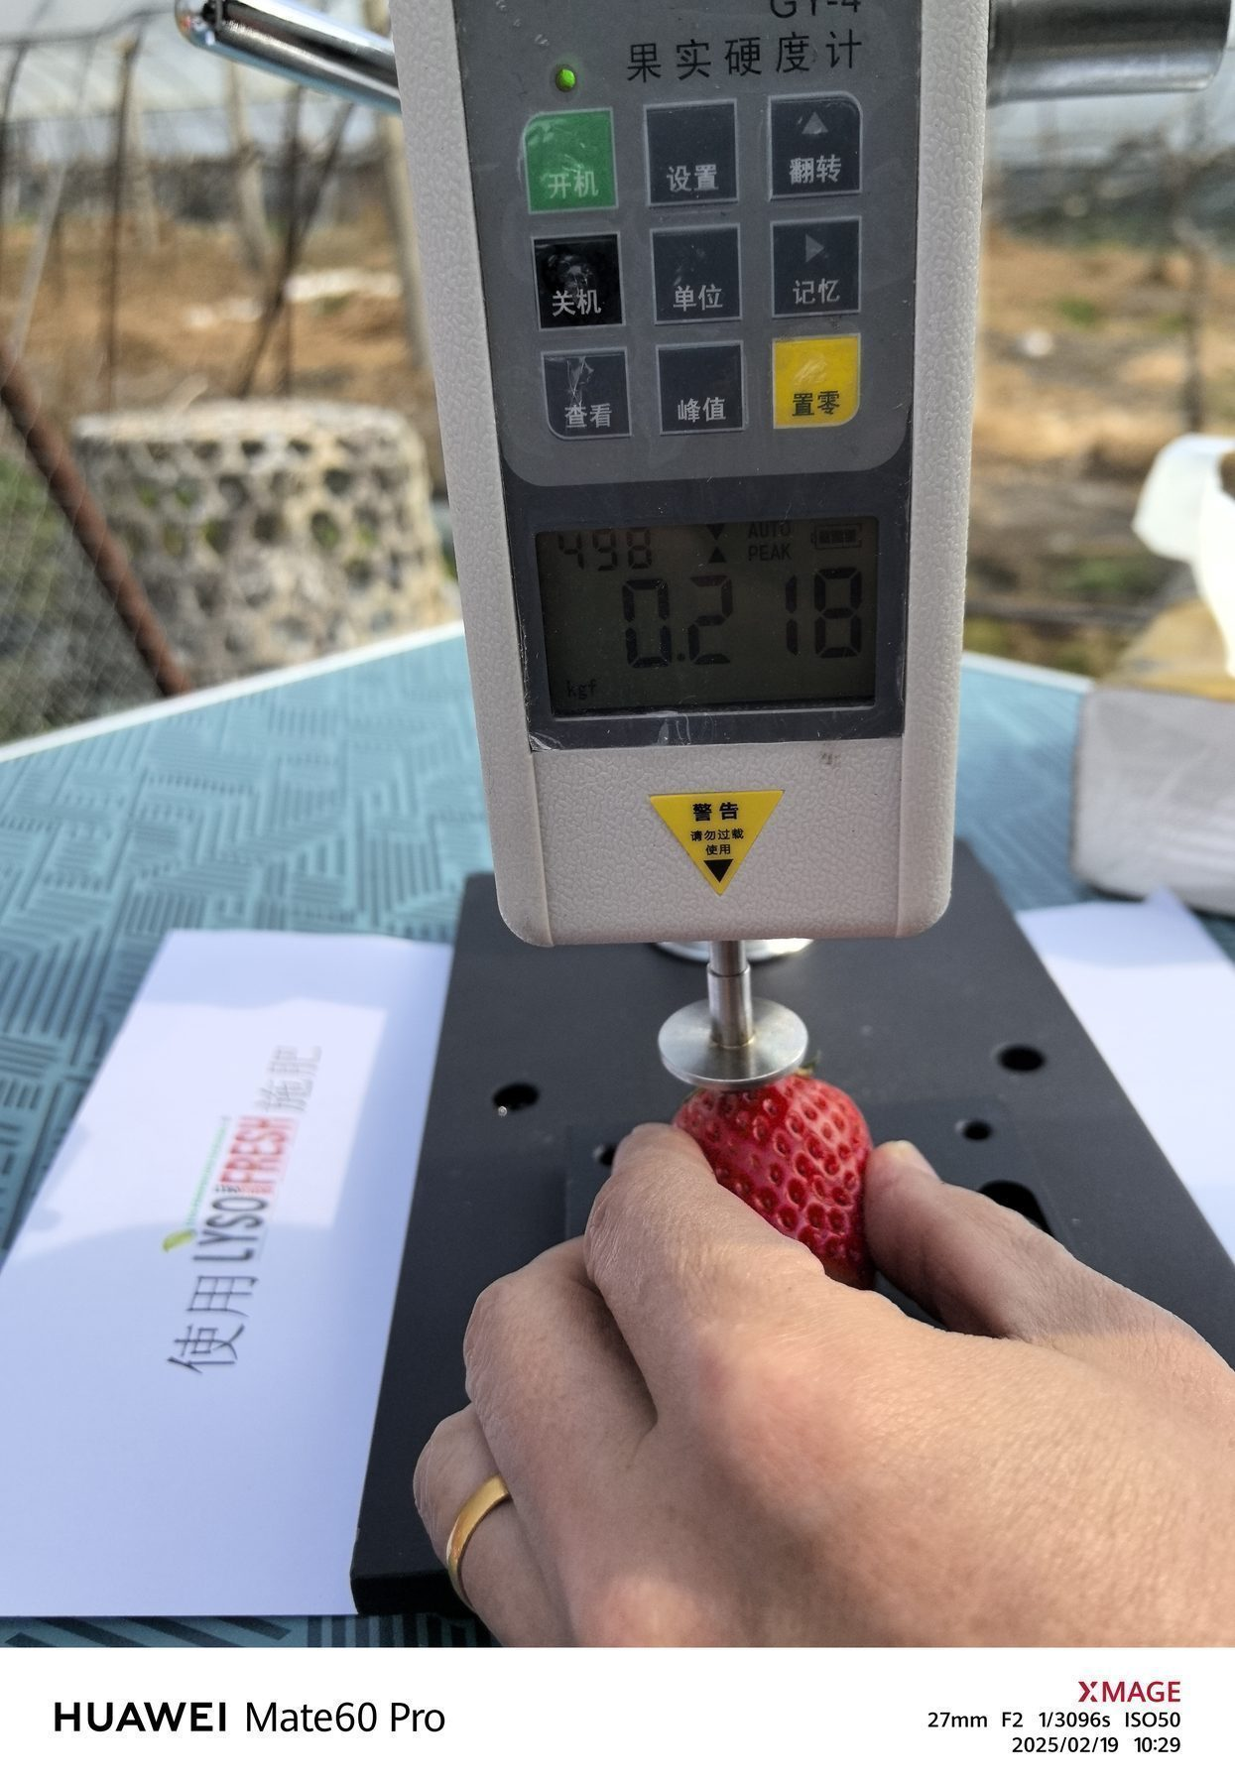
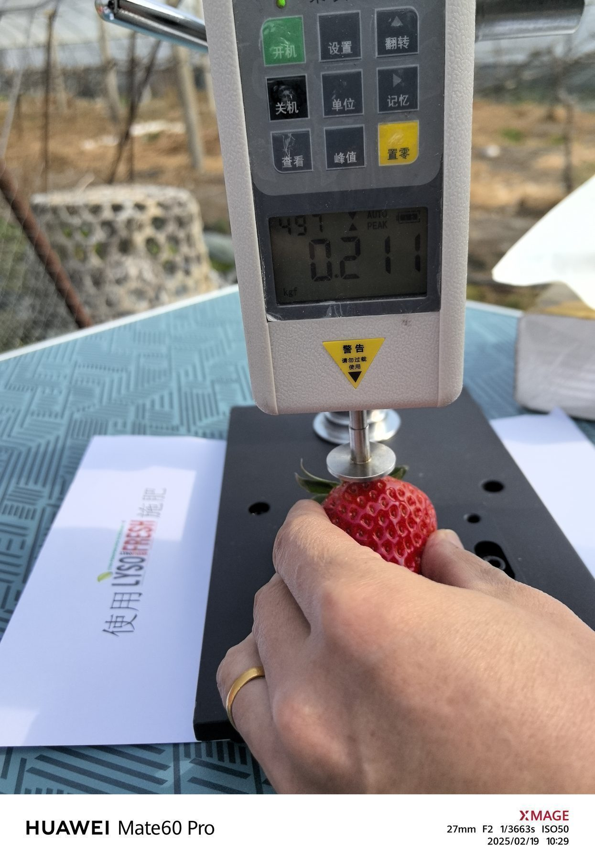
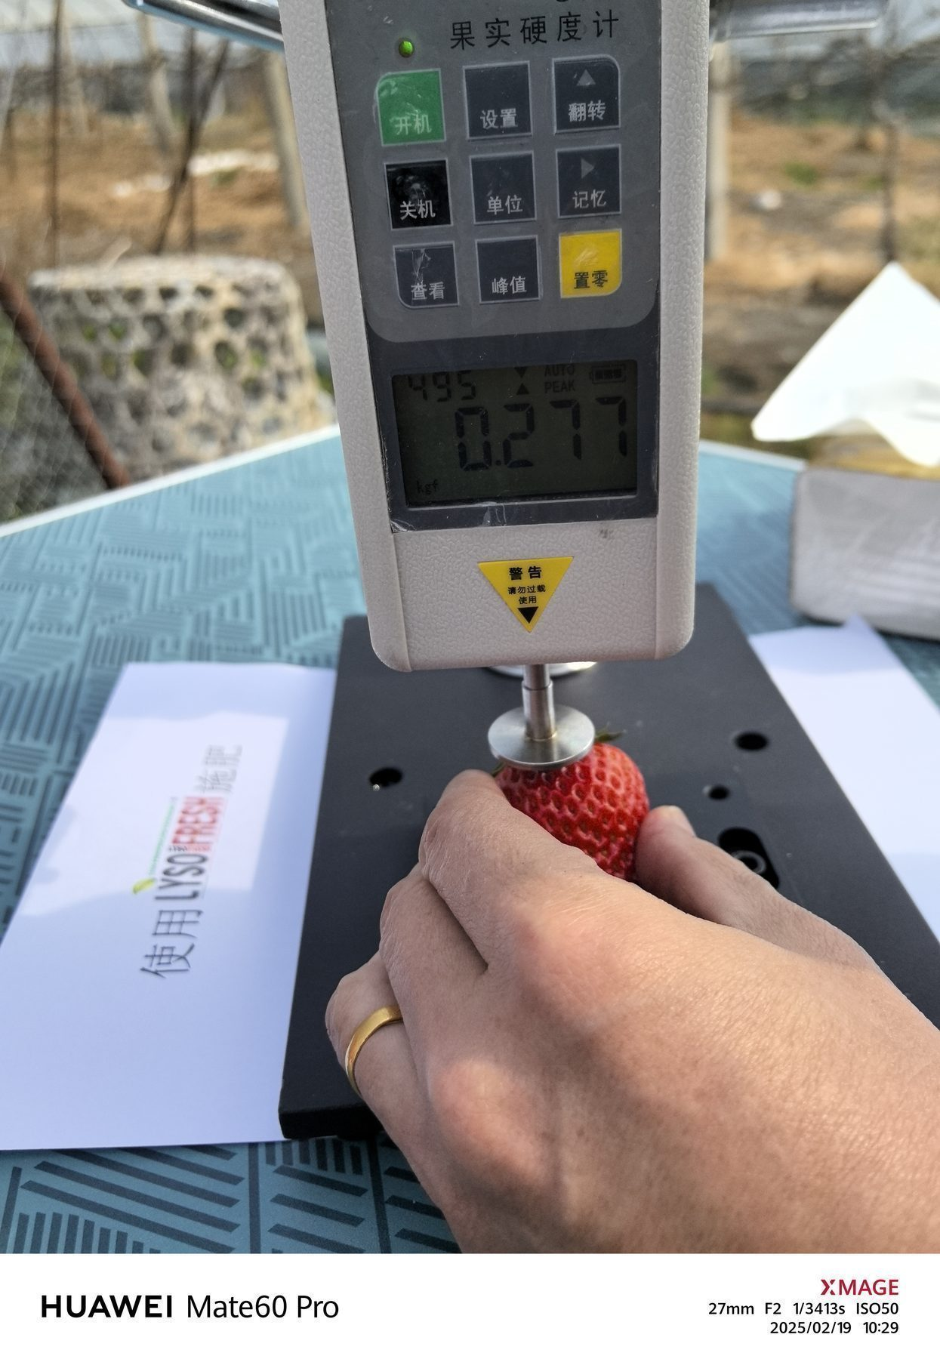
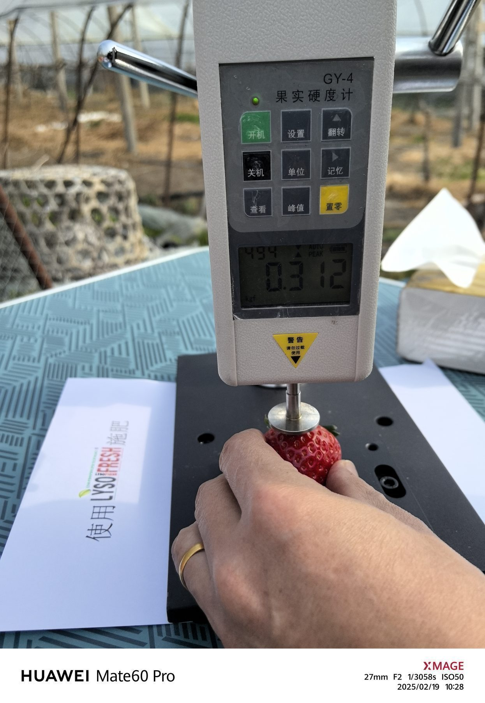
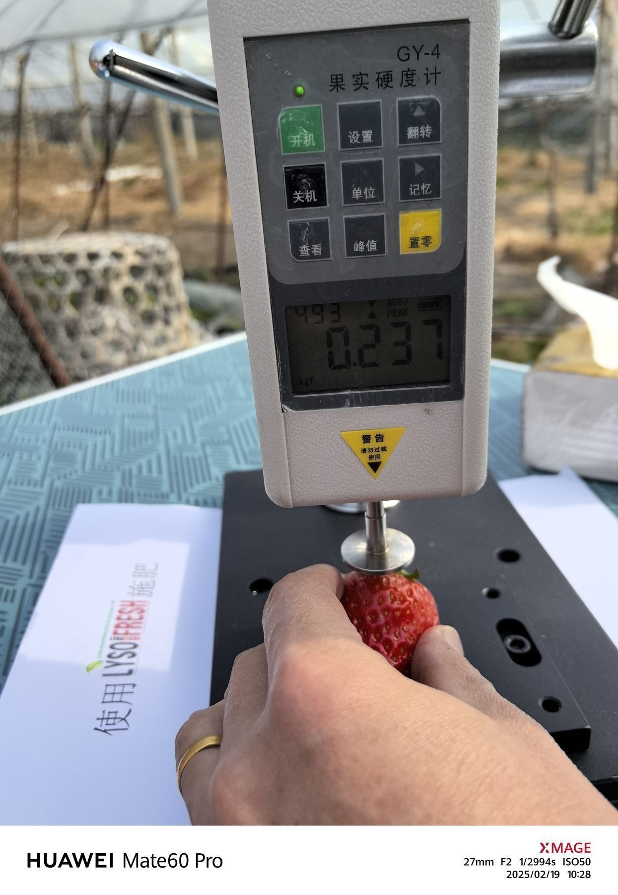
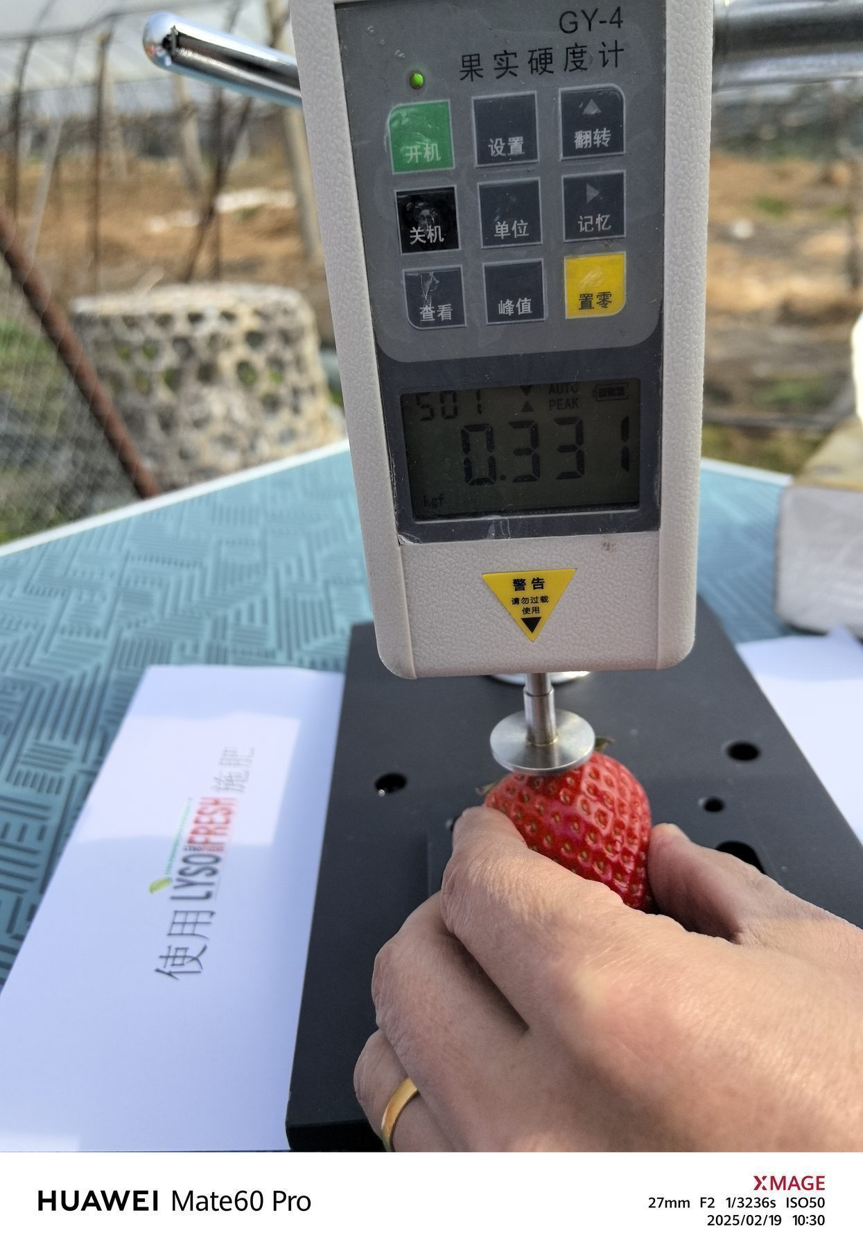
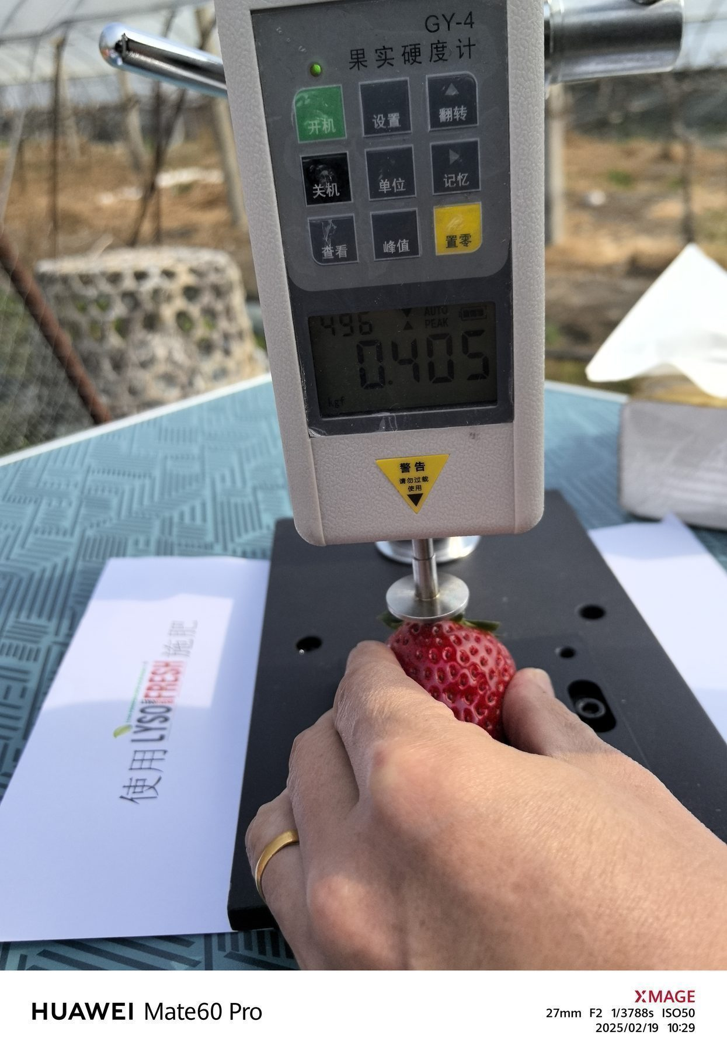
Test Results –Photo of firmness measurement
Measurement Date：2025-2-19
FRUITQ+ TREATED
FRUITQ+
FRUITQ+
FRUITQ+
FRUITQ+
FRUITQ+
FRUITQ+
FRUITQ+
FRUITQ+
FRUITQ+
FRUITQ+

Slide 9
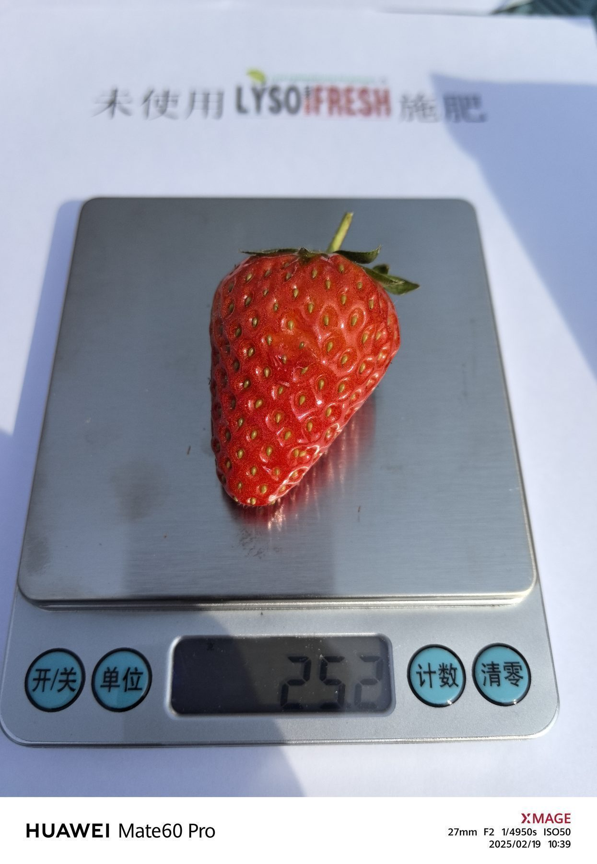
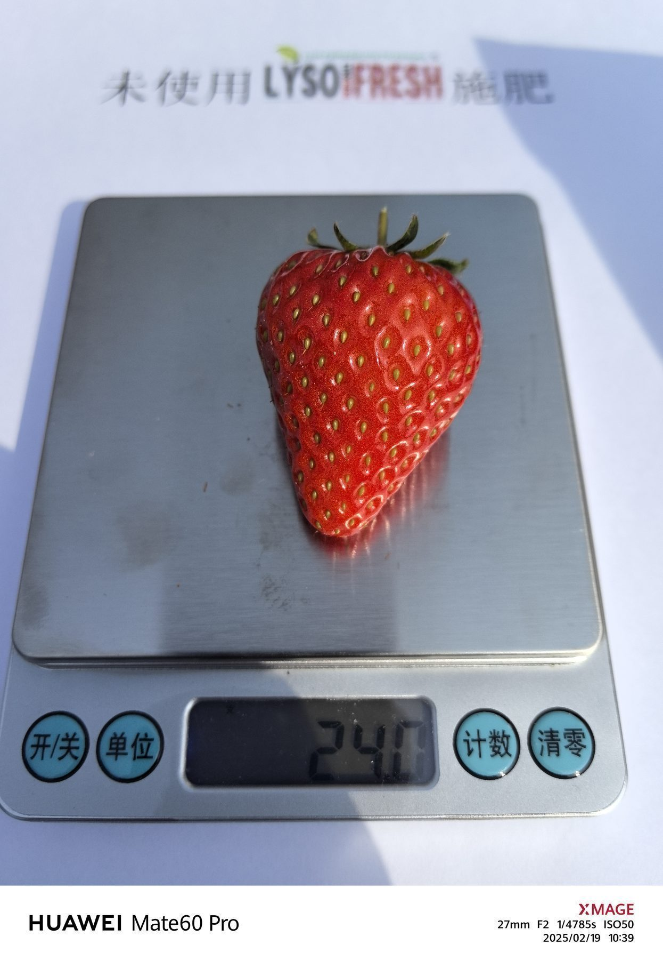
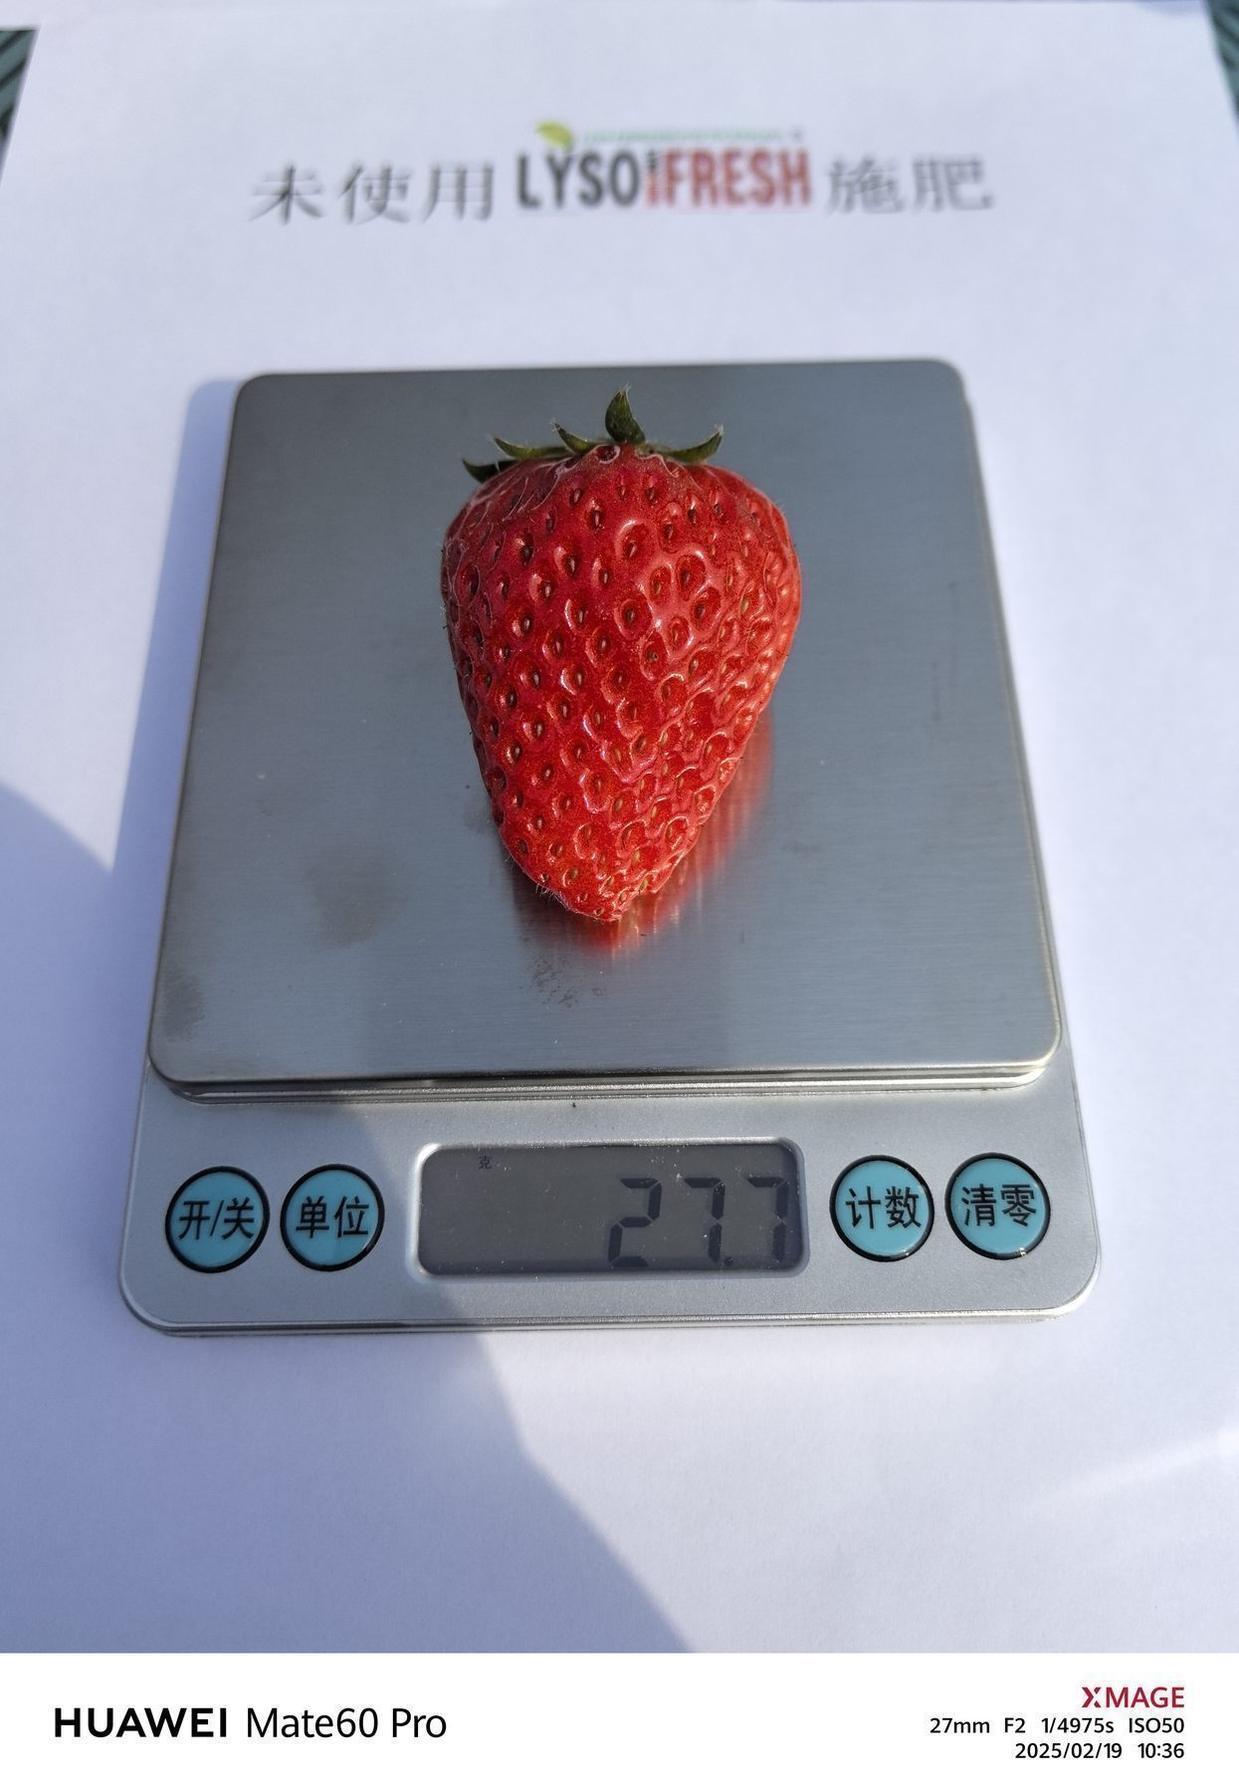
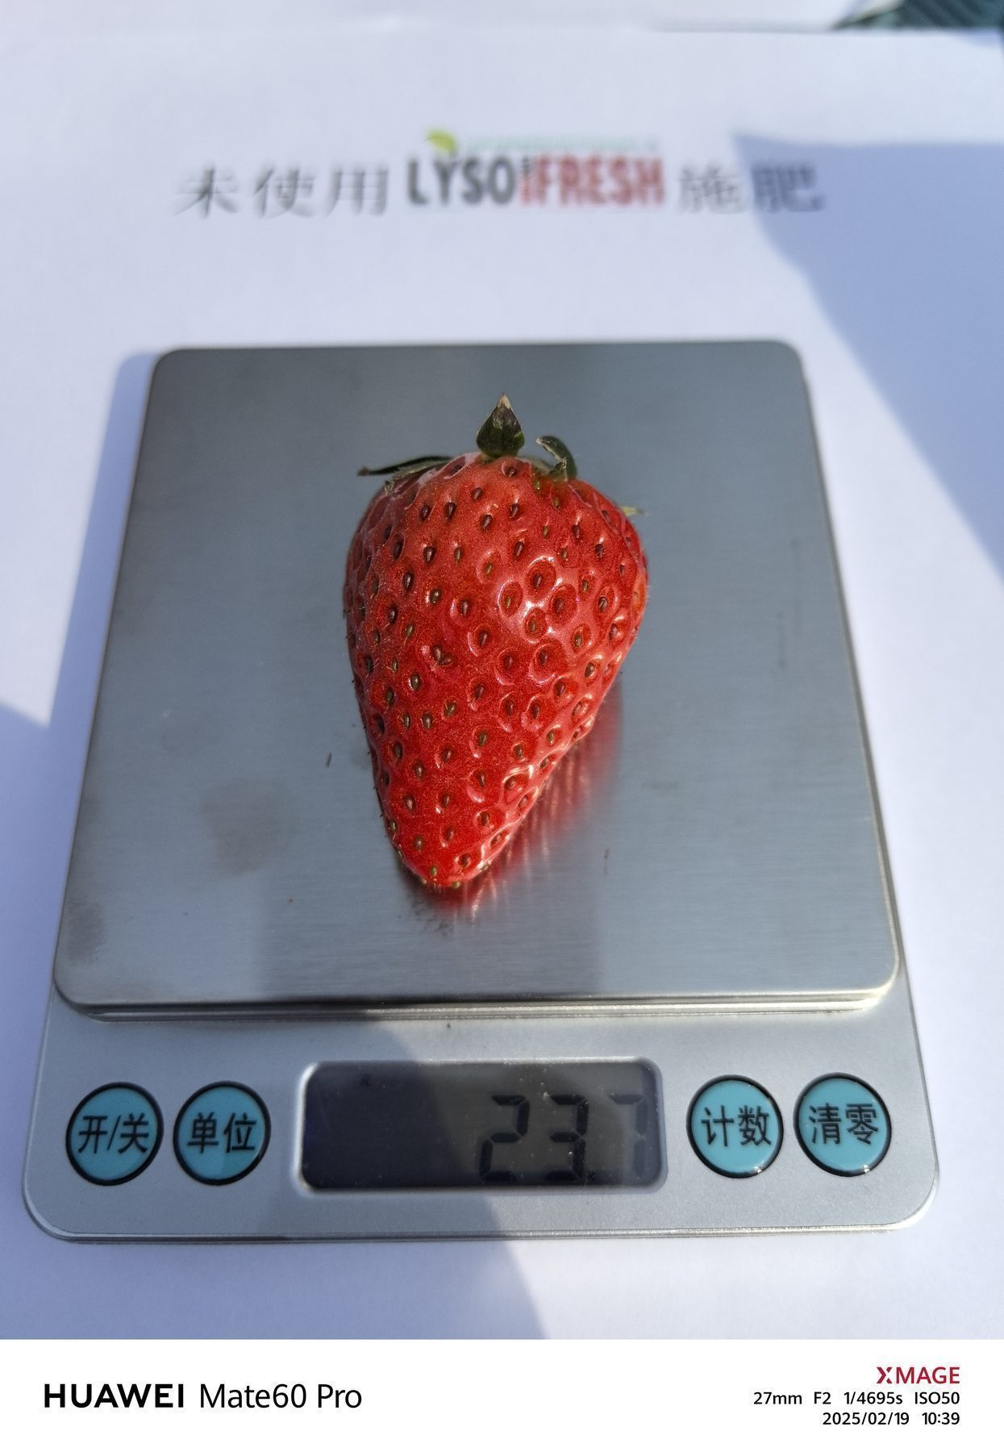
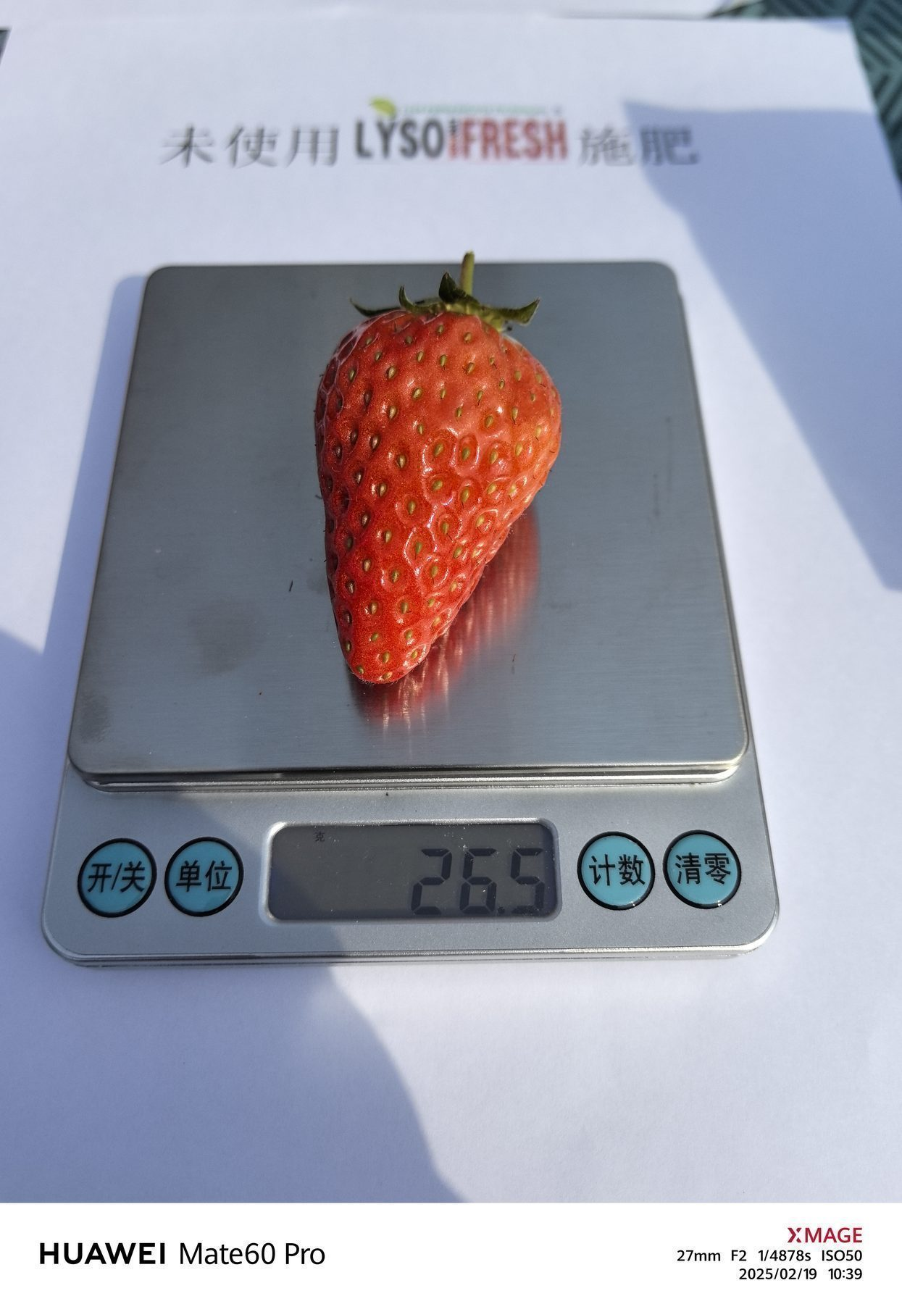
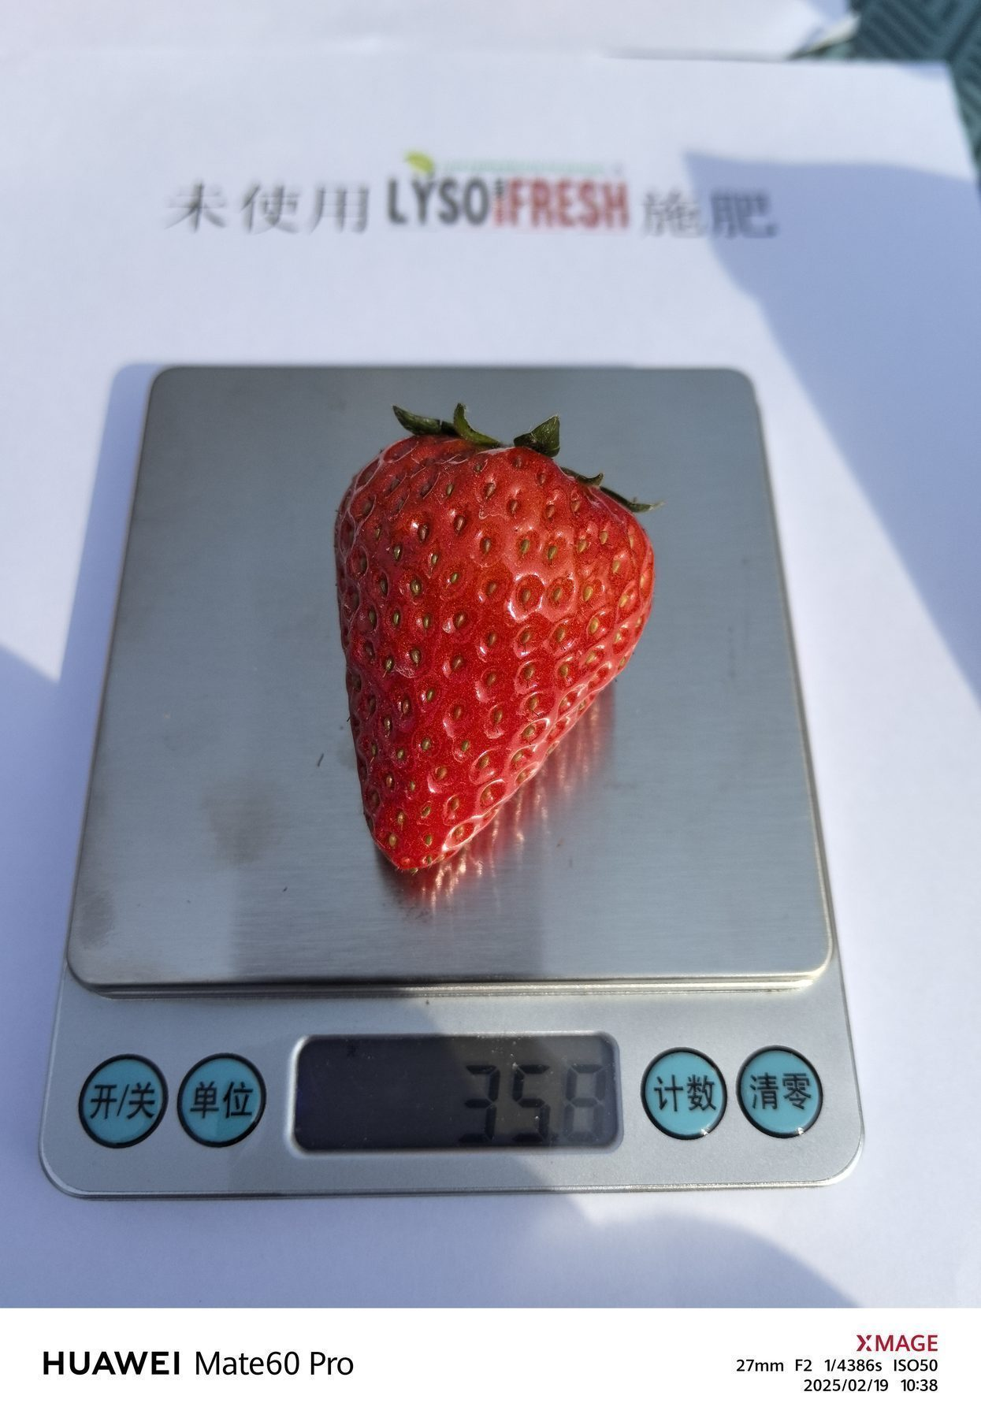
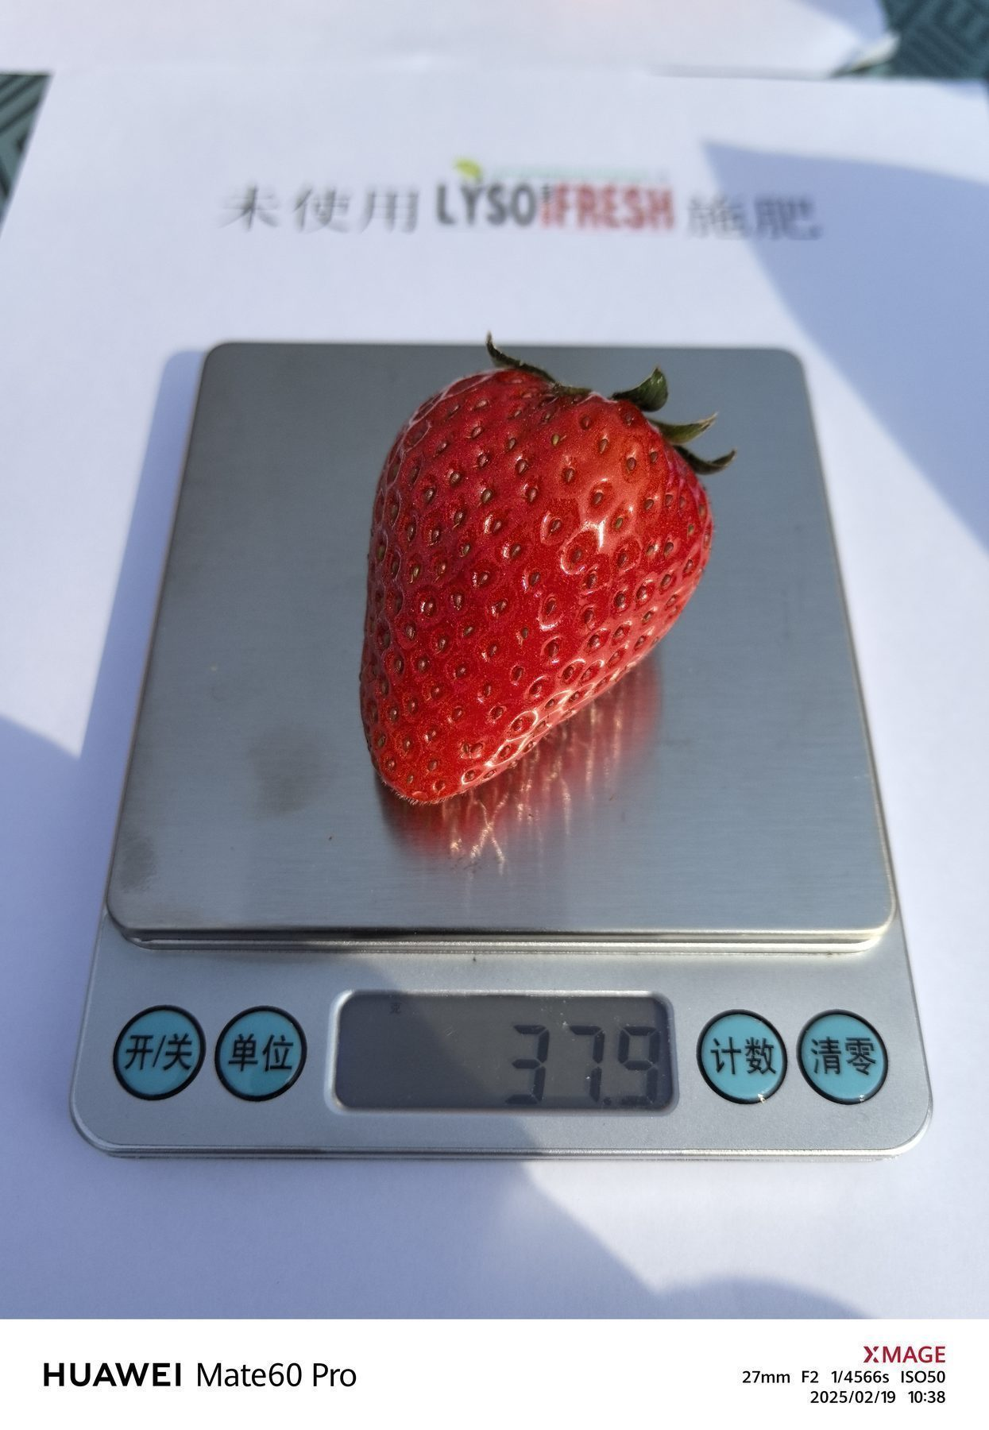



Test Results –Photo of Weight per unit
Measurement Date：2025-2-19
CONTROL
CONTROL
CONTROL
CONTROL
CONTROL
CONTROL
CONTROL
CONTROL
CONTROL
CONTROL
CONTROL

Slide 10










Test Results –Photo of Weight per unit
Measurement Date：2025-2-19
FRUITQ+ TREATED
FRUITQ+
FRUITQ+
FRUITQ+
FRUITQ+
FRUITQ+
FRUITQ+
FRUITQ+
FRUITQ+
FRUITQ+
FRUITQ+

Slide 11



Post-Trial Market Observation
Fruit from the trial was offered for sale following harvest, providing a practical market observation after the field evaluation.

Slide 12

FRUITQ+
Enhance Quality
Field Evidence · Huzhou, China
Maximize Nature’s Potential, Naturally.
Powered by LPE Technology
Science for Better Harvests.

