Slide 1
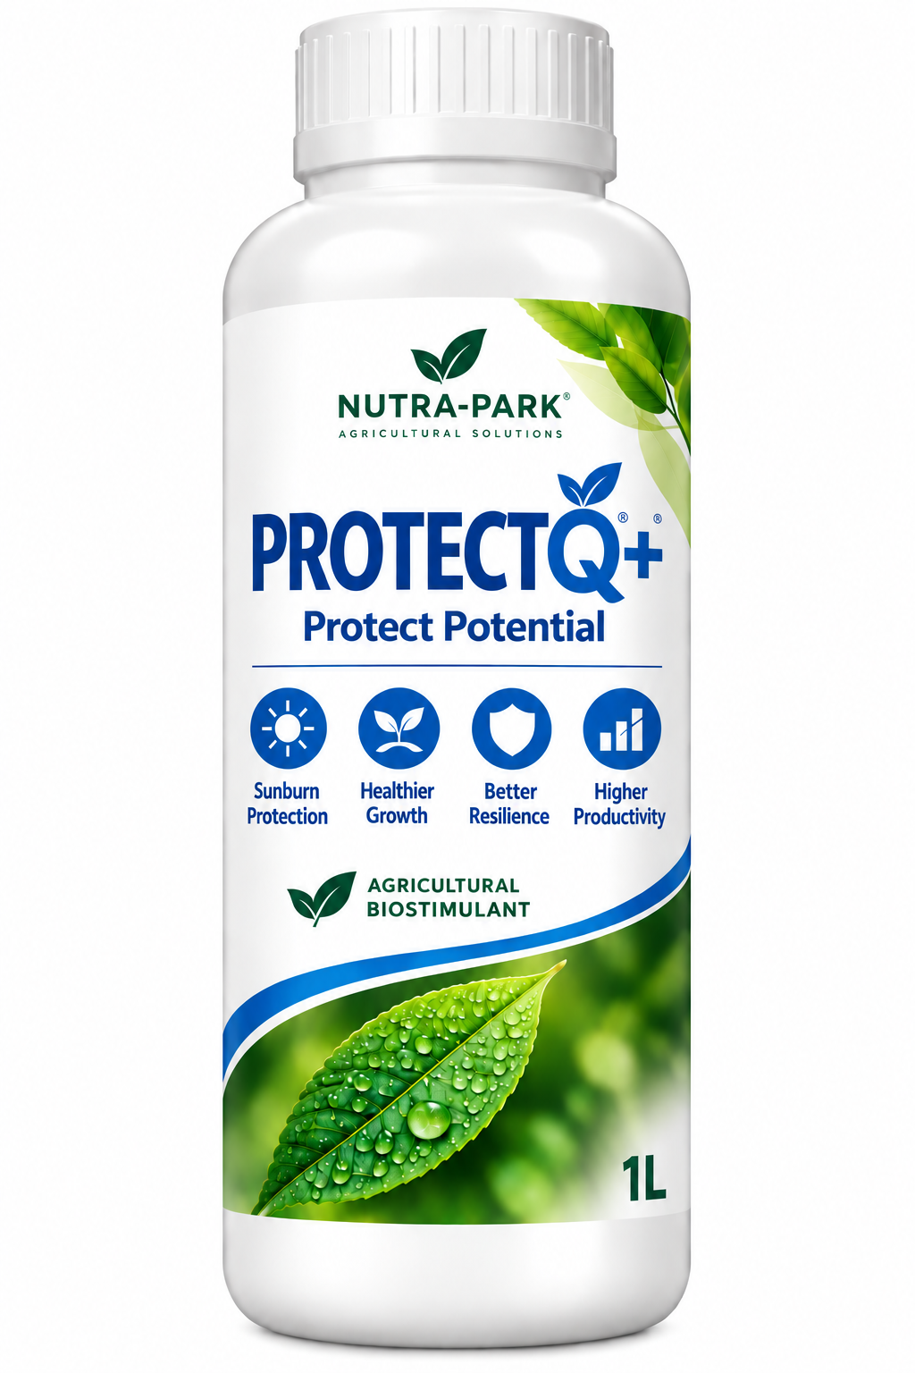

PROTECTQ+
PROTECT POTENTIAL
Technical & Field Evidence
Sunburn Protection · Cracking Reduction
Healthier Growth · Better Resilience
Phospholipid-based crop protection for high-value fruit under environmental stress.
2026

Slide 2
PRODUCT OVERVIEW
ProtectQ+ | Protect Potential
A phospholipid-based biostimulant designed to help crops maintain quality under stress.
01
SUNBURN PROTECTION
02
HEAT STRESS PROTECTION
Helps reduce damage under intense sunlight and high temperature.
Supports plant performance under heat and drought conditions.
03
CRACKING PROTECTION
04
RESILIENCE BOOST
Supports skin elasticity under moisture-related stress.
Supports plant resilience and stable performance.
NUTRA-PARK | Science for Better Harvests
2

Slide 3
TECHNICAL PROFILE
Composition & Product Characteristics
ProtectQ+ Certificate of Analysis · Lot PQ2602 · 10 Aug 2026
TEST ITEM
SPECIFICATION
ANALYTICAL VALUE
Total Nitrogen
≥ 1.0%
1.12%
P₂O₅
≥ 1.5%
1.56%
K₂O
≥ 1.5%
1.58%
Boron (B₂O₃)
≥ 0.05%
0.061%
Zinc (Zn)
≥ 0.08%
0.09%
pH (1:10)
6.0–8.0
7.5
Solubility at 20°C
100%
100%
Density at 20°C
—
1.040 g/mL
NUTRA-PARK | Science for Better Harvests
3

Slide 4
FORMULATION
Ingredient Profile
Current ProtectQ+ ingredient certificate
Phospholipid (soybean extract)
7%
Dextrose (cornstarch)
8%
Glycerine (vegetable)
10%
Oleic acid (sunflower seed)
7.5%
Potassium phosphate
3%
Potassium acetate
1.2%
Boric acid
0.12%
Zinc sulfate
0.5%
Clean water
62.68%
100% total formulation · Water soluble at 20°C
NUTRA-PARK | Science for Better Harvests
4

Slide 5
PRODUCT FUNCTION
How ProtectQ+ Supports Crop Protection
A functional framework based on the supplied formulation and technical information.
1
2
3
4
→
→
→
MEMBRANE SUPPORT
CUTICLE & SURFACE
STRESS RESPONSE
CROP QUALITY
Phospholipid components are intended to support cell membrane condition and tissue stability.
Designed to support fruit surface condition under sunlight and moisture-related stress.
Helps crops maintain performance under heat, sunlight and moisture fluctuation.
Maintaining healthier tissues may help preserve crop quality and marketability.
Protect Potential → Support tissue condition → Help reduce stress-related damage → Preserve marketable quality
NUTRA-PARK | Science for Better Harvests
5

Slide 6
APPLICATION
General Use Guidance
General guidance from the supplied technical sheet. Always follow local registration, crop-specific recommendations and approved label directions.
FRUIT CROPS
VEGETABLES
TARGET CROPS
TARGET CROPS
Table grape · citrus · blueberry · peach · mandarin · cherry · apple
Tomato · strawberry · cucumber · pepper and vegetables
DOSE
TIMING
DOSE
TIMING
150–200 cc / 100 L water
2–3 L/ha
After fruit set; repeat 3–4 times every 12–15 days.
100–150 cc / 100 L water
1.5–2 L/ha
From early flowering; repeat 3–4 times every 14–21 days.
NUTRA-PARK | Science for Better Harvests
6

Slide 7
FIELD EVIDENCE
Cherry Cracking Trial | Chile, 2024–2025
Santina cherry · Rain-induced cracking · Chile, 2024–2025
CROP / VARIETY
Cherry / Santina
TRIAL DESIGN
OBJECTIVE
Minimize rain-induced fruit cracking
T0
CONTROL
TREATMENTS
T0 Control · T1 ProtectQ+ 300 cc hL⁻¹ ×3
T2 Competitor 100 g hL⁻¹ ×3
T1
PROTECTQ+
APPLICATION DATES
18 Nov · 25 Nov · 2 Dec 2024
T2
COMPETITOR
EVALUATION
Cracking incidence · fruit size/weight · yield · °Brix · dry matter
3 applications · 100 fruit per treatment for cracking assessment
NUTRA-PARK | Science for Better Harvests
7

Slide 8
FIELD EVIDENCE
Cherry Trial | Key Results
Chile · 2024–2025 · Cracking Index (IC)
CONTROL
PROTECTQ+
COMPETITOR
LOWER CRACKING INDEX
44.8 → 30.6
OTHER QUALITY MEASURES
Fruit diameter, fruit weight and °Brix did not show statistically significant differences in the supplied report.
44.8
30.6
33.8
Santina cherry · Chile · 2024–2025
NUTRA-PARK | Science for Better Harvests
8

Slide 9
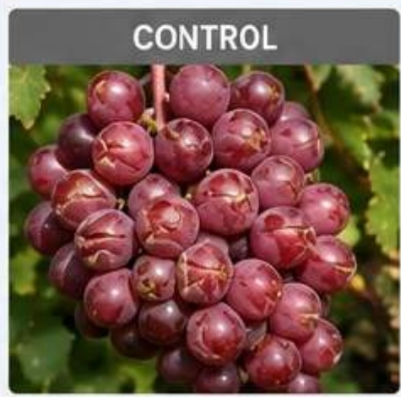
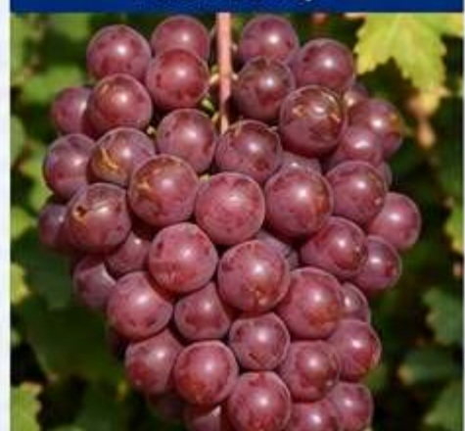
FIELD EVIDENCE
Grape | Cracking Comparison
Shine Muscat · Gimcheon, Korea · 2022 · T1 treatment vs untreated Control
CONTROL
PROTECTQ+
GRAPE CRACKING
28.5% → 12.3%
56.8% lower
TRIAL PROGRAM
3 applications · 3 L/ha
May 10 · May 24 · Jun 10, 2022
NUTRA-PARK | Science for Better Harvests
9

Slide 10
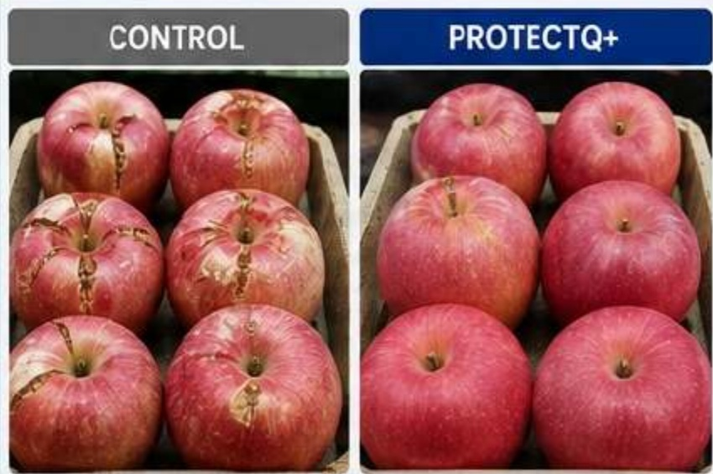
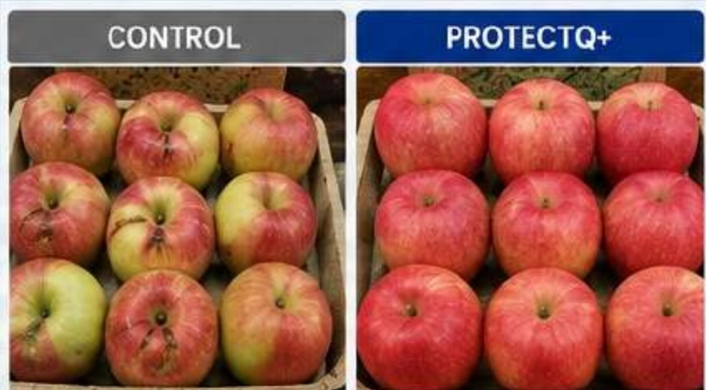
FIELD EVIDENCE
Fuji Apple | Two Evidence Sets
Keep the controlled Andong trial and the Korea-China replicated evidence distinct.
ANDONG, KOREA · 2022
17.2% → 7.1%
Crack + sunburn damage · 58.7% lower
Control vs ProtectQ+
KOREA & CHINA · 2022 · 3 REPLICATED TRIALS
23.8% → 63.5%
High-quality fruit (> $50/box) · +39.7 points
Replicated field comparison
NUTRA-PARK | Science for Better Harvests
10

Slide 11
EVIDENCE SUMMARY
What the Field Evidence Shows
Different source sets are kept distinct rather than merged into one trial narrative.
CHERRY
GRAPE
APPLE
Chile · 2024–25
Gimcheon · 2022
Andong · 2022
Cracking Index
Cracking
Crack + sunburn
44.8 → 30.6
28.5% → 12.3%
17.2% → 7.1%
Santina cherry
Shine Muscat
Fuji apple
Results are trial-specific. Grape: Shine Muscat, Gimcheon 2022. Apple damage: Fuji, Andong 2022. The separate 23.8% → 63.5% high-quality-fruit result comes from 3 replicated Fuji trials in Korea & China (2022).
NUTRA-PARK | Science for Better Harvests
11

Slide 12
PROTECTQ+
Protect Potential
LESS DAMAGE.
MORE MARKETABLE FRUIT.
Sunburn Protection · Heat Stress Protection
Cracking Protection · Resilience Boost
Protect Potential. Preserve Quality. Create Value.
www.nutra-park.com

